Slide 1

AlertSphere: Disaster Tweet Detector
Al Saim Shakeel
Mohd. Faraz Khan
Ahtisham Riyasat
Supervised by
Mr. Aaftab Ala

Slide 2
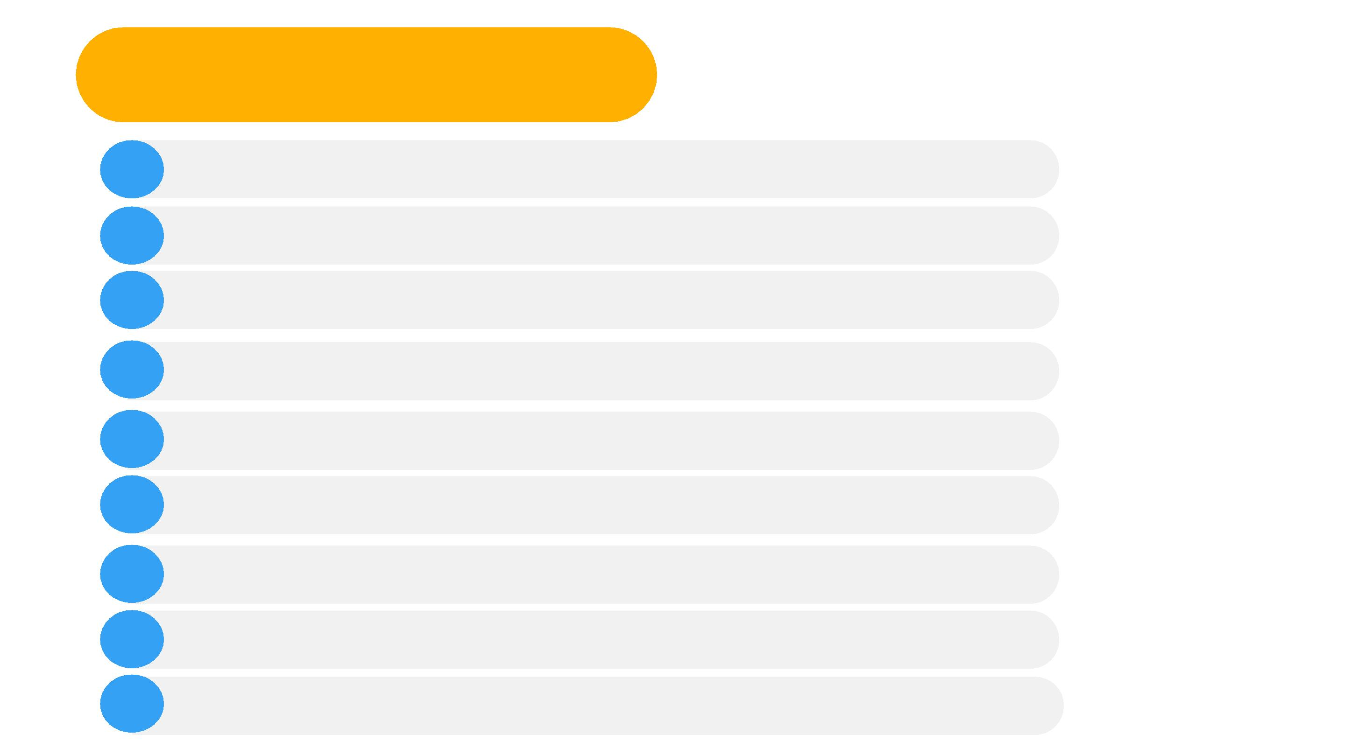
Table of Contents
1
Introduction
2 Methodology
3 System Design: Requirement, H/w and S/w
5 Implementation
6 Outcome or Results and Analysis
7 Conclusion
8 Future Work
9 References
9
Appendices

Slide 3

Introduction
Welcome to AlertSphere: Disaster Tweet Detector. In today's
digital age, social media plays a pivotal role in disseminating
real-time information during disasters. Our project focuses
on developing a predictive model to identify disaster-related
tweets, aiding in timely response and management efforts.
Let's explore how AlertSphere revolutionizes disaster
management through advanced machine learning techniques.
AlertSphere is a machine learning-based system designed to
predict whether a given tweet indicates a disaster. It utilizes
natural language processing (NLP) techniques to analyze the
text content of tweets and classify them as either disaster-
related or not.
BACK TO TABLE OF CONTENTS

Slide 4
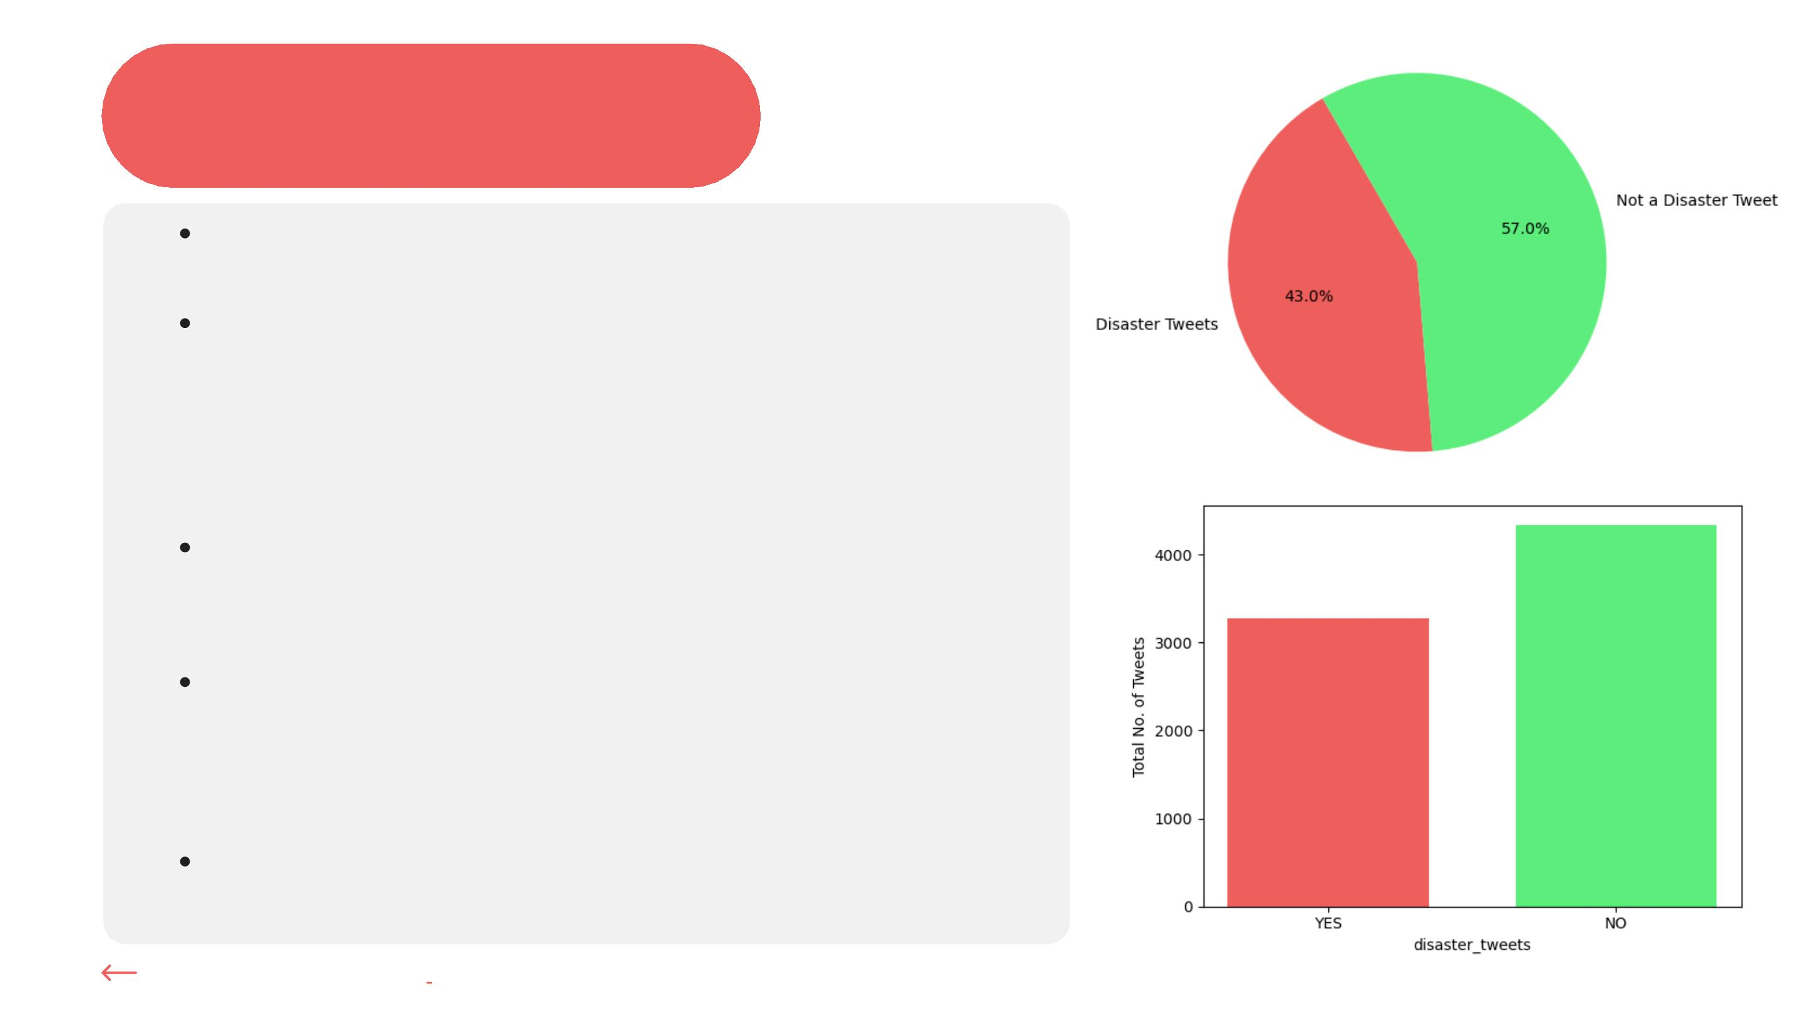
Methodology
Data acquisition from Kaggle
Data preprocessing & Feature Engineering steps:
handling null values, tokenization, lowercasing,
punctuation removal, stop word elimination,
stemming or lemmatization
Transform words into vectors Count
Vectorization or TF-IDF Vectorization
Model selection: Multinomial Naïve Bayes
Classification, Logistic Regression, KNN
Classification
Model training, evaluation, and validation using
performance metrics
BACK TO INTRODUCTION

Slide 5
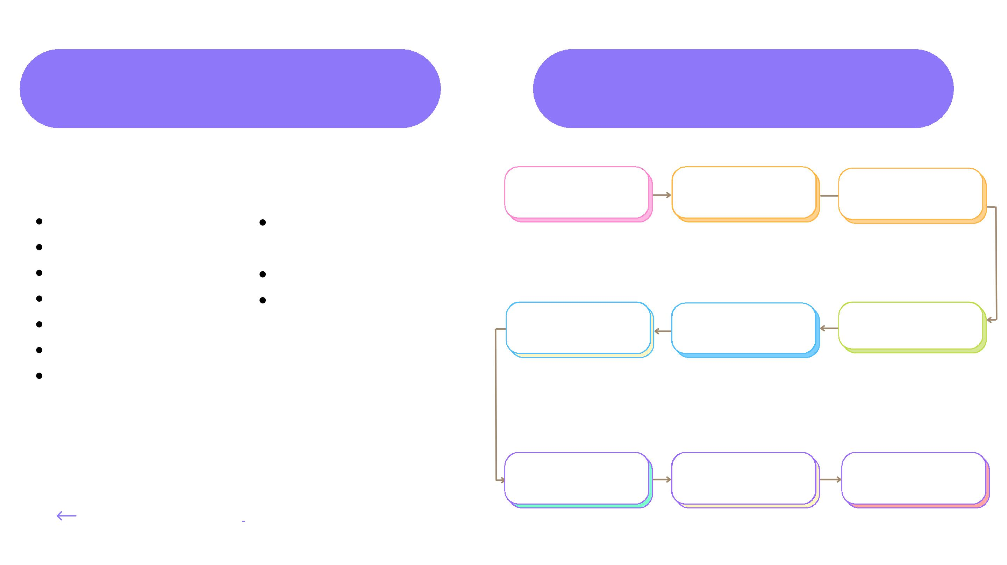
System Requirements
System Design
Software:
Hardware:
DATA
PREPROCESSING
FEATURE
ENGINEERING
READ DATASET
Jupyter Notebook
Standard multicore
Anaconda
NLTK
Scikit-learn
Matplotlib
Tkinter
processor
Adequate RAM
Sufficient disk space
SPLIT DATA INTO
TRAINING AND TEST
DATA
SELECT FEATURE
AND TARGET
TRANSFORM WORDS
INTO VECTORS
Pandas
COMPUTE METRICS &
CLASSIFICATION
REPORT
IDENTIFY BEST
MODEL
DEPLOY MODEL
INTO UI
BACK TO METHODOLOGY

Slide 6

Implementation
In the implementation phase, we executed a systematic approach to
develop the AlertSphere system. This involved data acquisition from
Kaggle, preprocessing of tweet data, including handling null values and
text cleaning. We transformed text into numerical vectors using Count
and TF-IDF Vectorization techniques, selected features, and targets for
model training. Various classification models were applied and evaluated
for performance. Finally, the trained model was deployed into a user-
friendly interface using Tkinter for real-time prediction.
BACK TO SYSTEM DESIGN

Slide 7
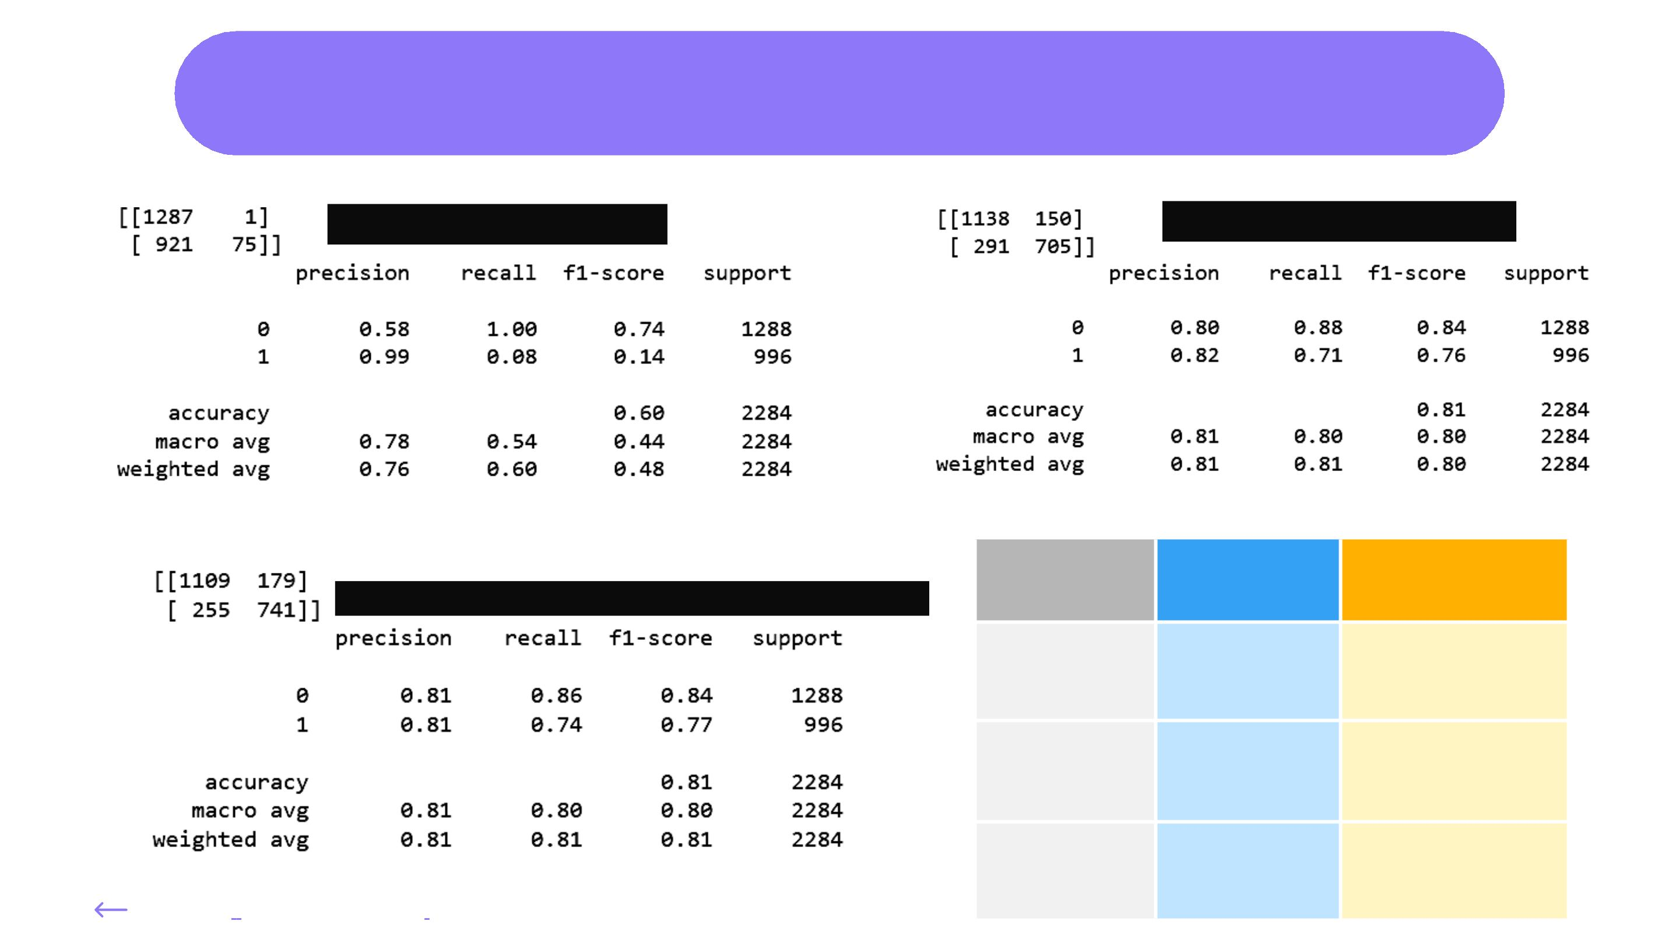
Outcome or Results and Analysis
KNN Classification
Logistic Regression
Multinomial Naïve Bayes Classification
Algorithm
Train Score
Test Score
KNN
61.89%
59.63%
Logistics
Regression
97.22%
92.86%
80.69%
81%
MNB
Classification
BACK TO IMPLEMENTATION

Slide 8
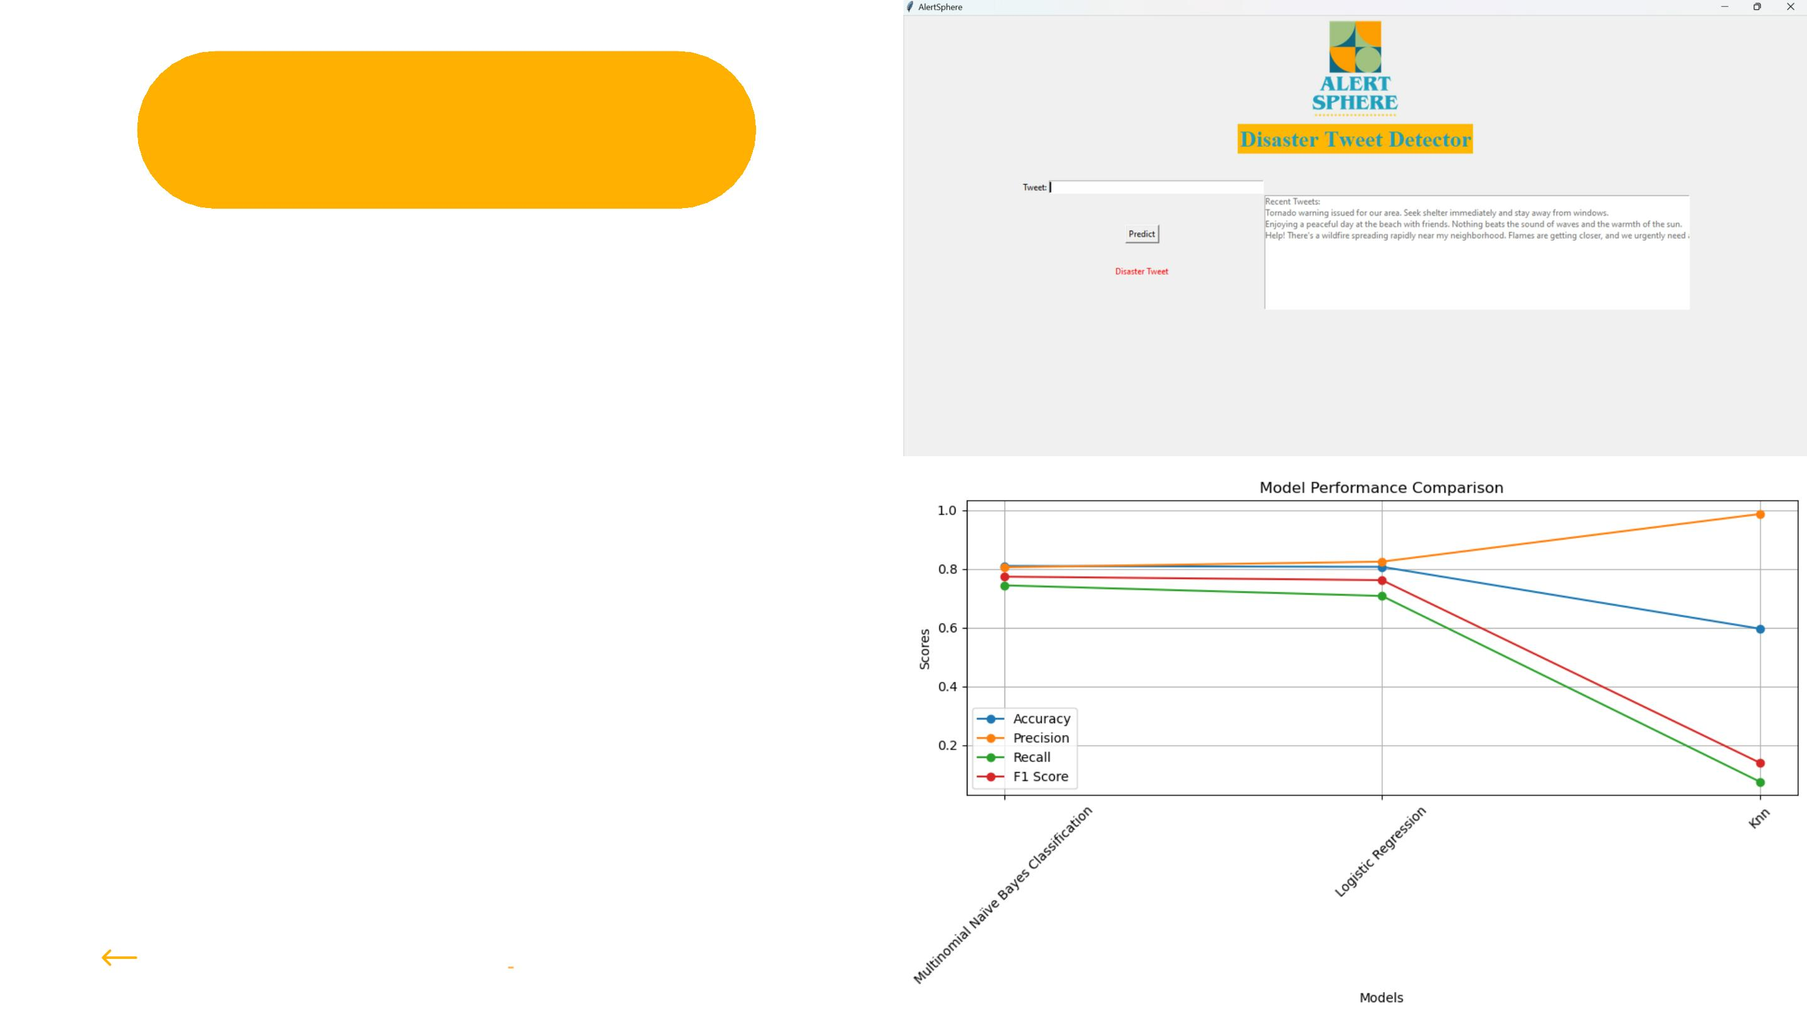
Conclusion
In conclusion, while evaluating the
performance of our classification models, we
observed that KNN Classification exhibited
the lowest accuracy at 60%, prompting its
exclusion from further consideration. Both
Multinomial Naïve Bayes Classification and
Logistic Regression demonstrated
comparable accuracies of 81%. However,
Logistic Regression displayed a notable
disparity between its high train score of 97%
and its slightly lower test score of 80%,
indicating a potential risk of overfitting.
Consequently, we opted to utilize Multinomial
Naïve Bayes Classification due to its stable
performance and absence of overfitting
concerns.
BACK TO OUTCOME & ANALYSIS

Slide 9

Future work
For future work, we envision enhancing the accuracy of the
AlertSphere system through the exploration of additional
methodologies and approaches. This may involve experimenting
with different machine learning algorithms, fine-tuning
hyperparameters, or incorporating advanced natural language
processing techniques. Furthermore, we aim to extend the
functionality of AlertSphere by integrating it with popular social
media platforms such as Twitter or threaded discussion forums.
This integration would enable real-time monitoring of social
media feeds, thereby enhancing the system's effectiveness in
disaster response and managementꢀefforts.
BACK TO CONCLUSION

Slide 10

Reference
1. Kaggle (for dataset):
https://www.kaggle.com/
2. Pandas documentation:
https://pandas.pydata.org/docs/
3. Matplotlib documentation:
https://matplotlib.org/stable/contents.html
4. Tkinter documentation:
https://docs.python.org/3/library/tkinter.html
5. Scikit-learn documentation
https://scikitlearn.org/stable/user_guide.html
BACK TO FUTURE WORK

Slide 11
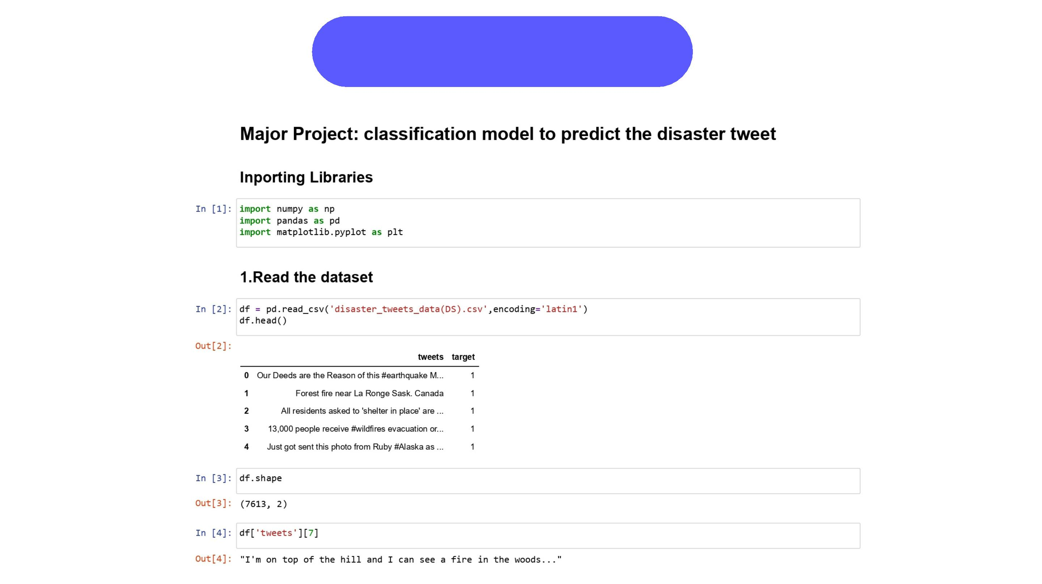
Appendices

Slide 12
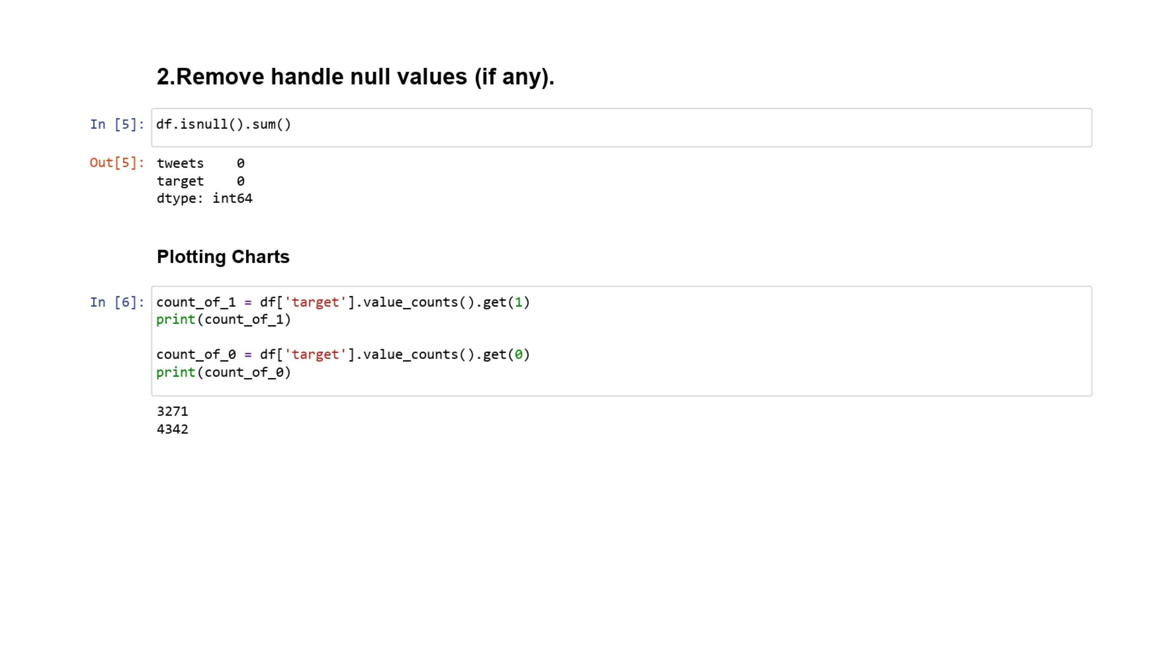

Slide 13
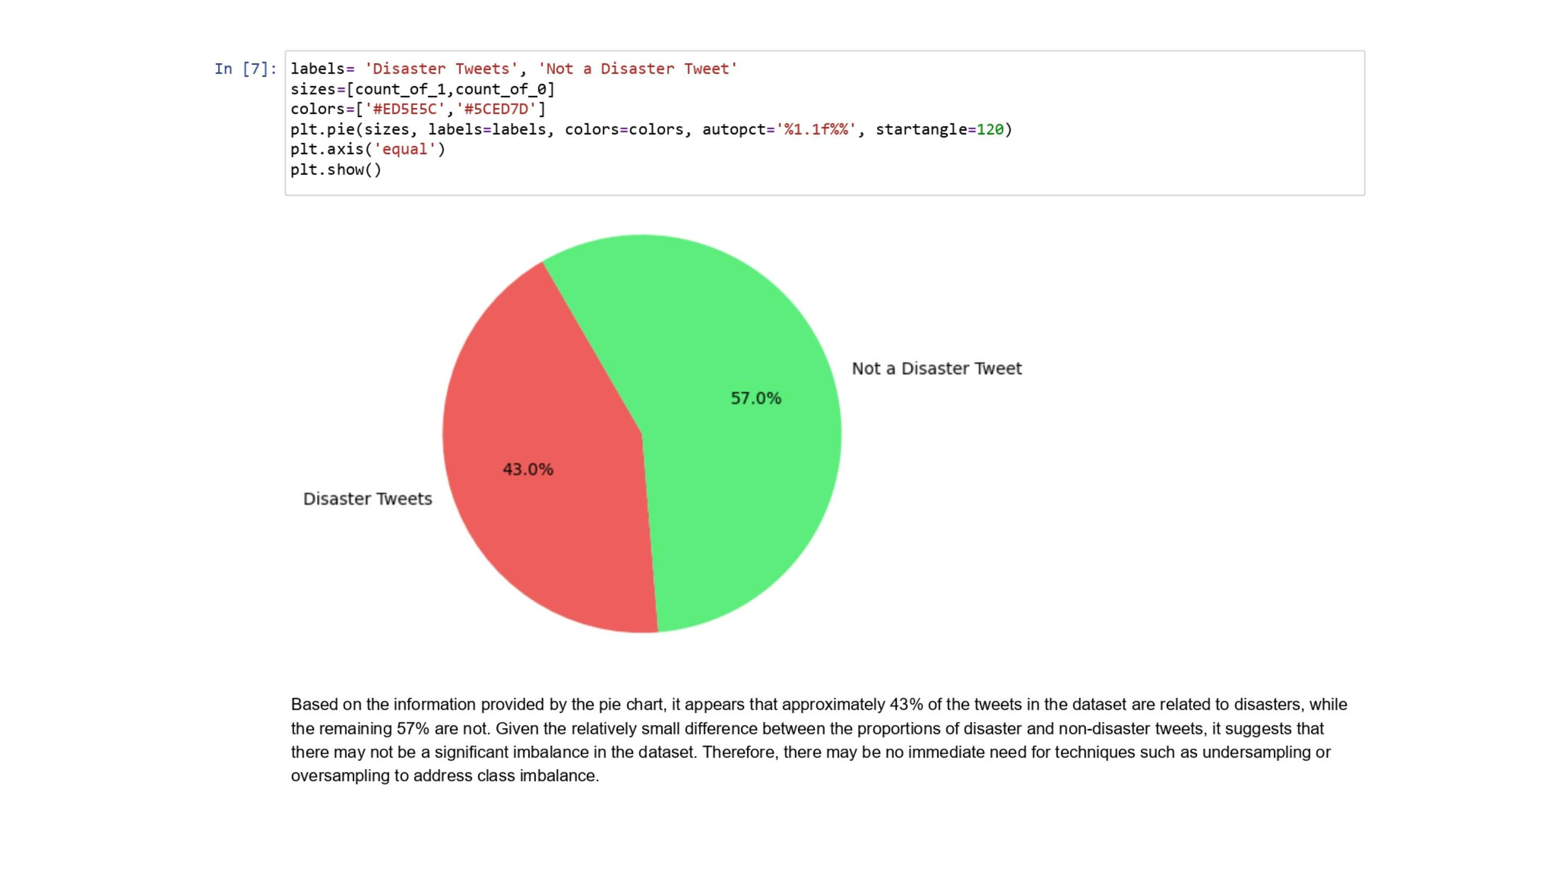

Slide 14
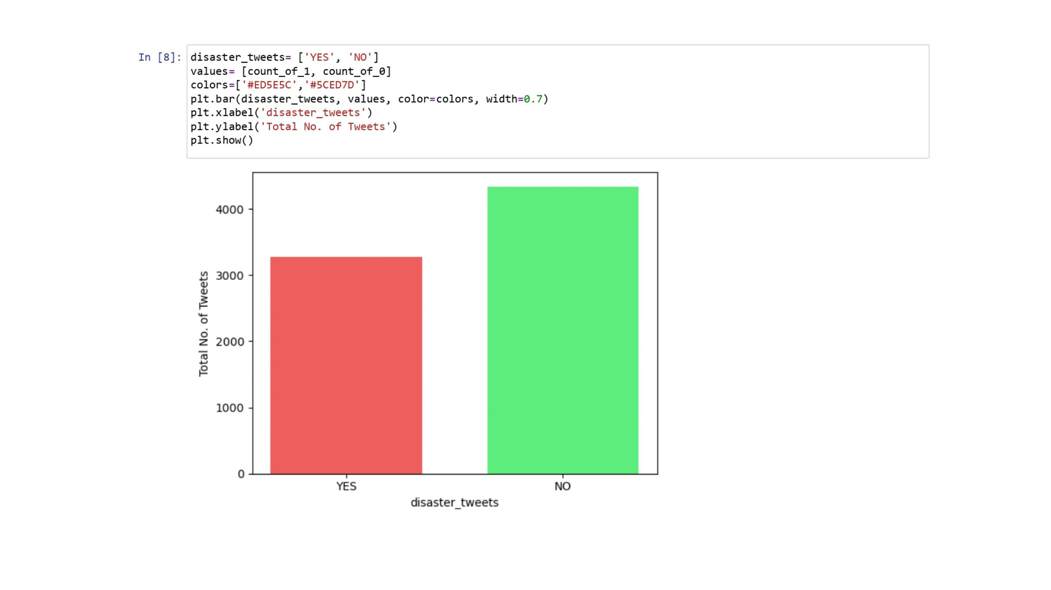

Slide 15
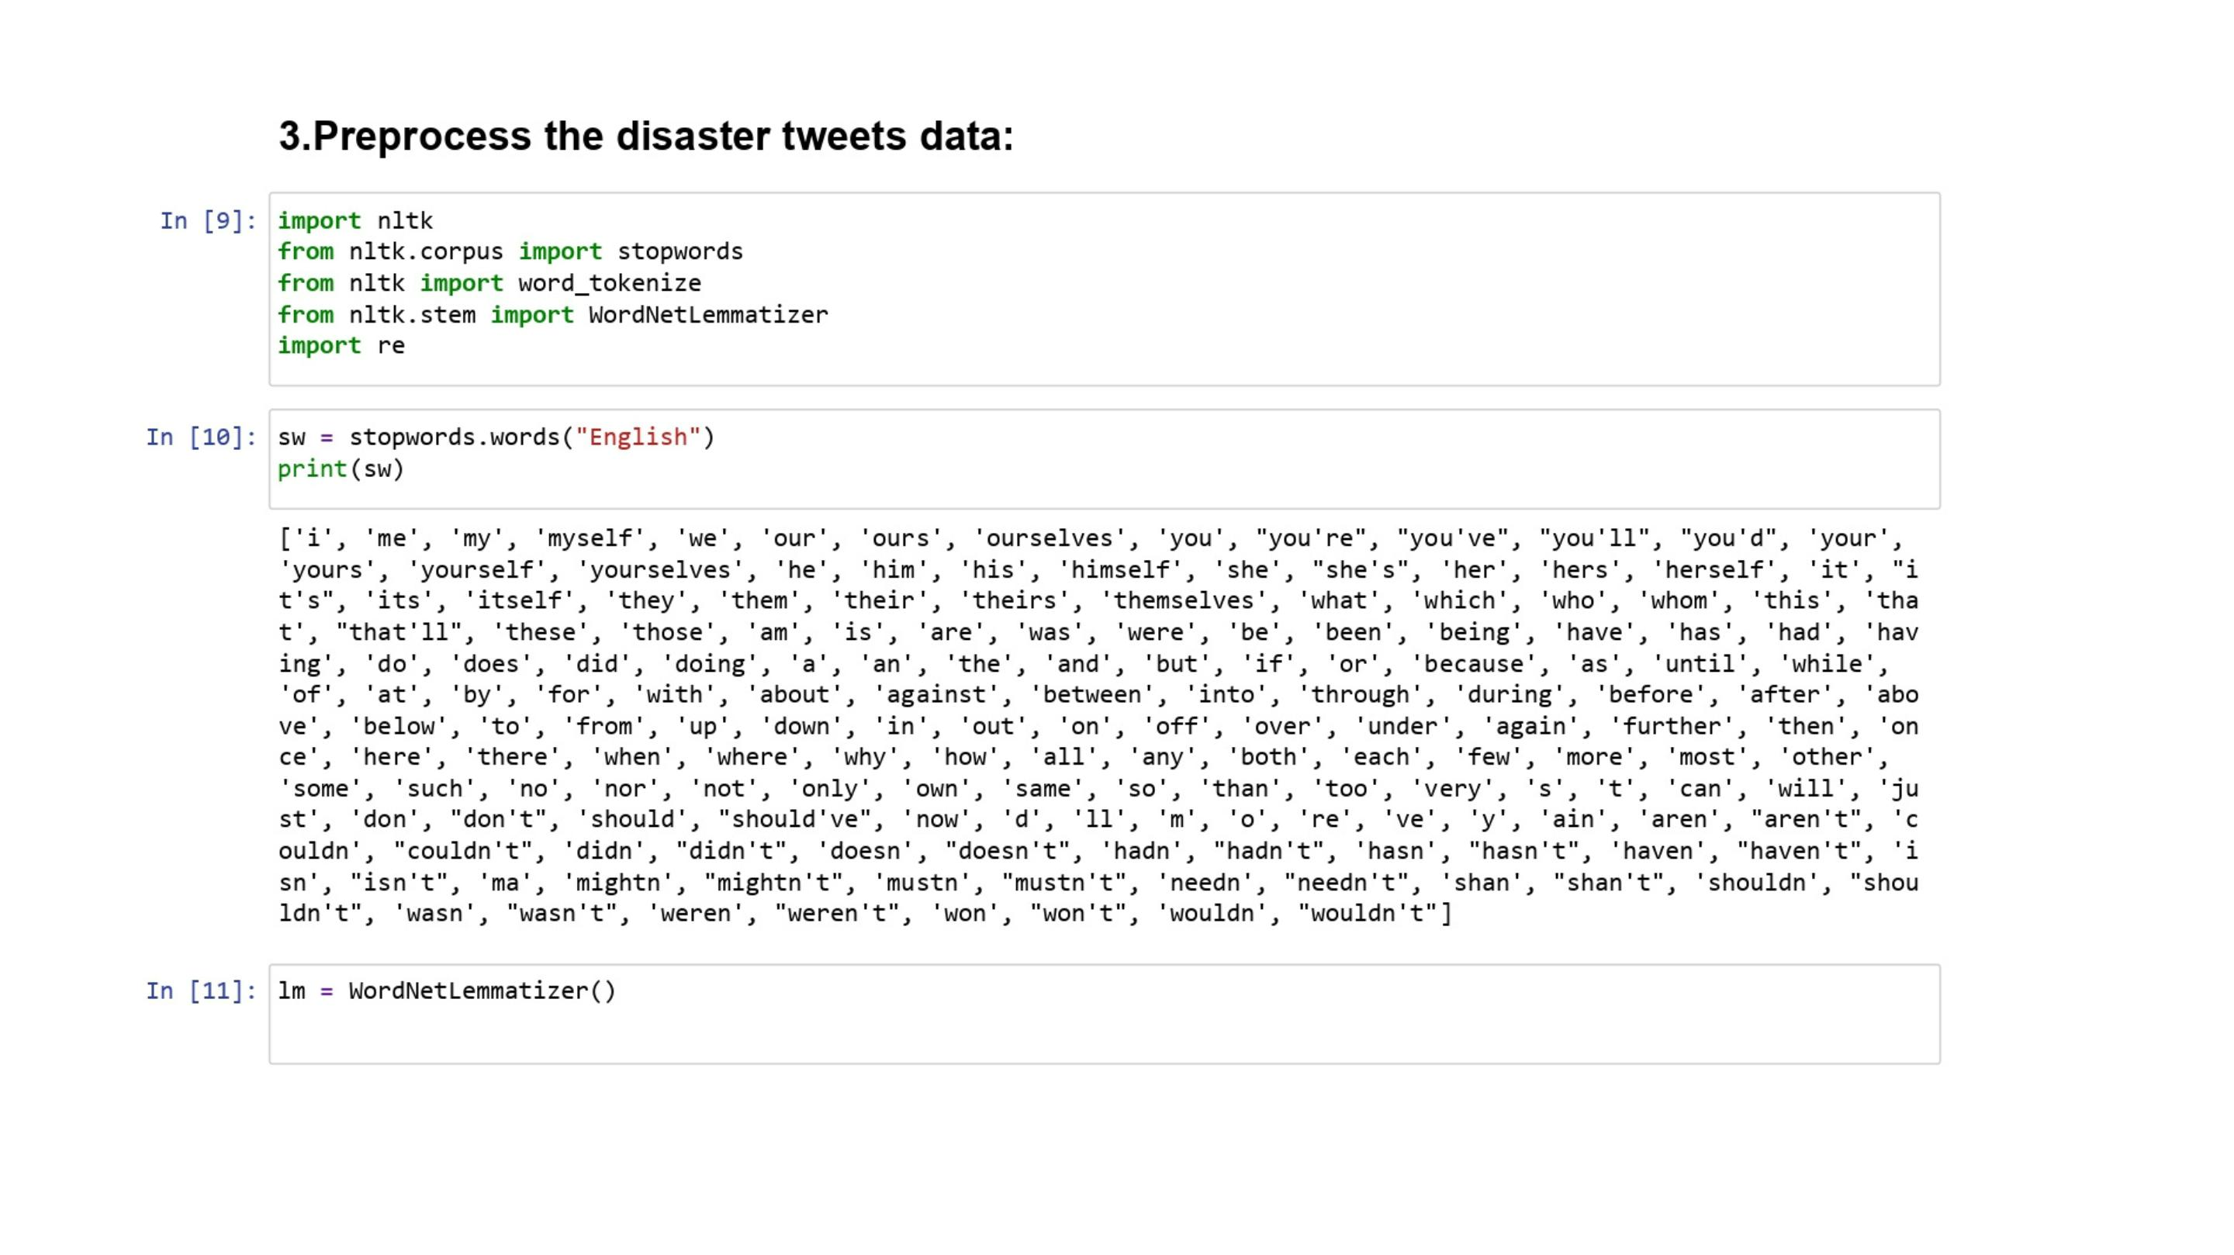

Slide 16
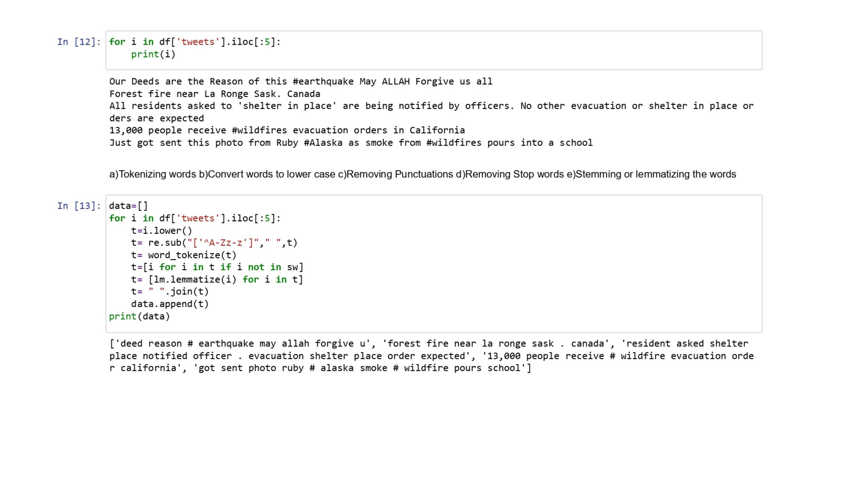

Slide 17
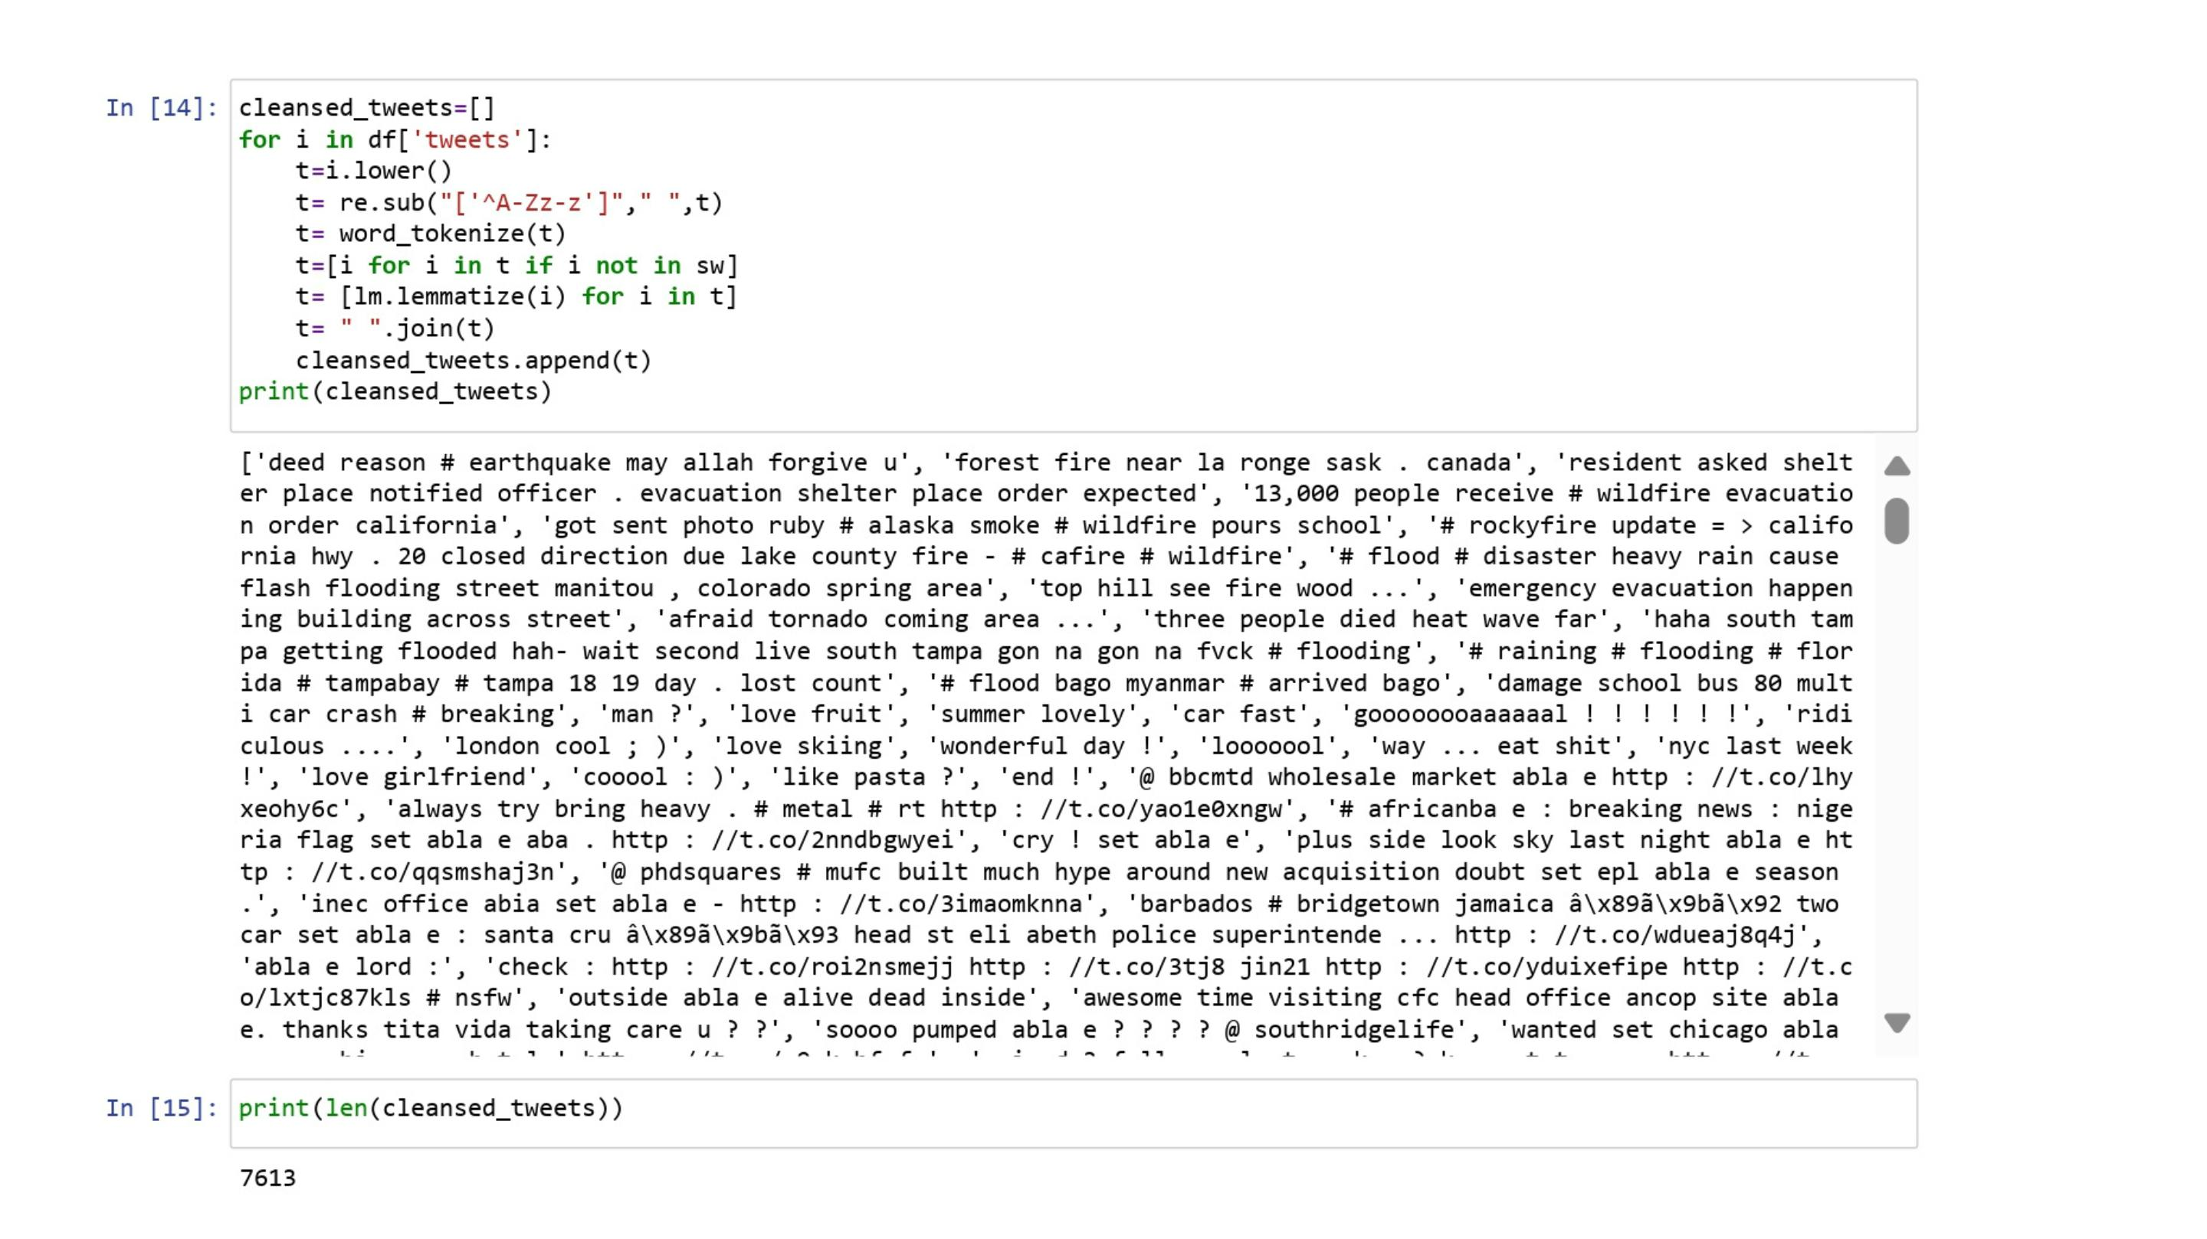

Slide 18
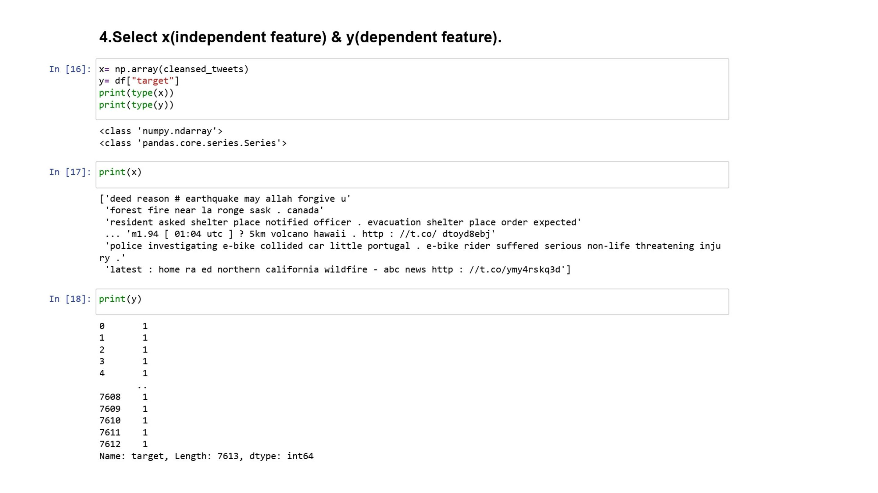

Slide 19
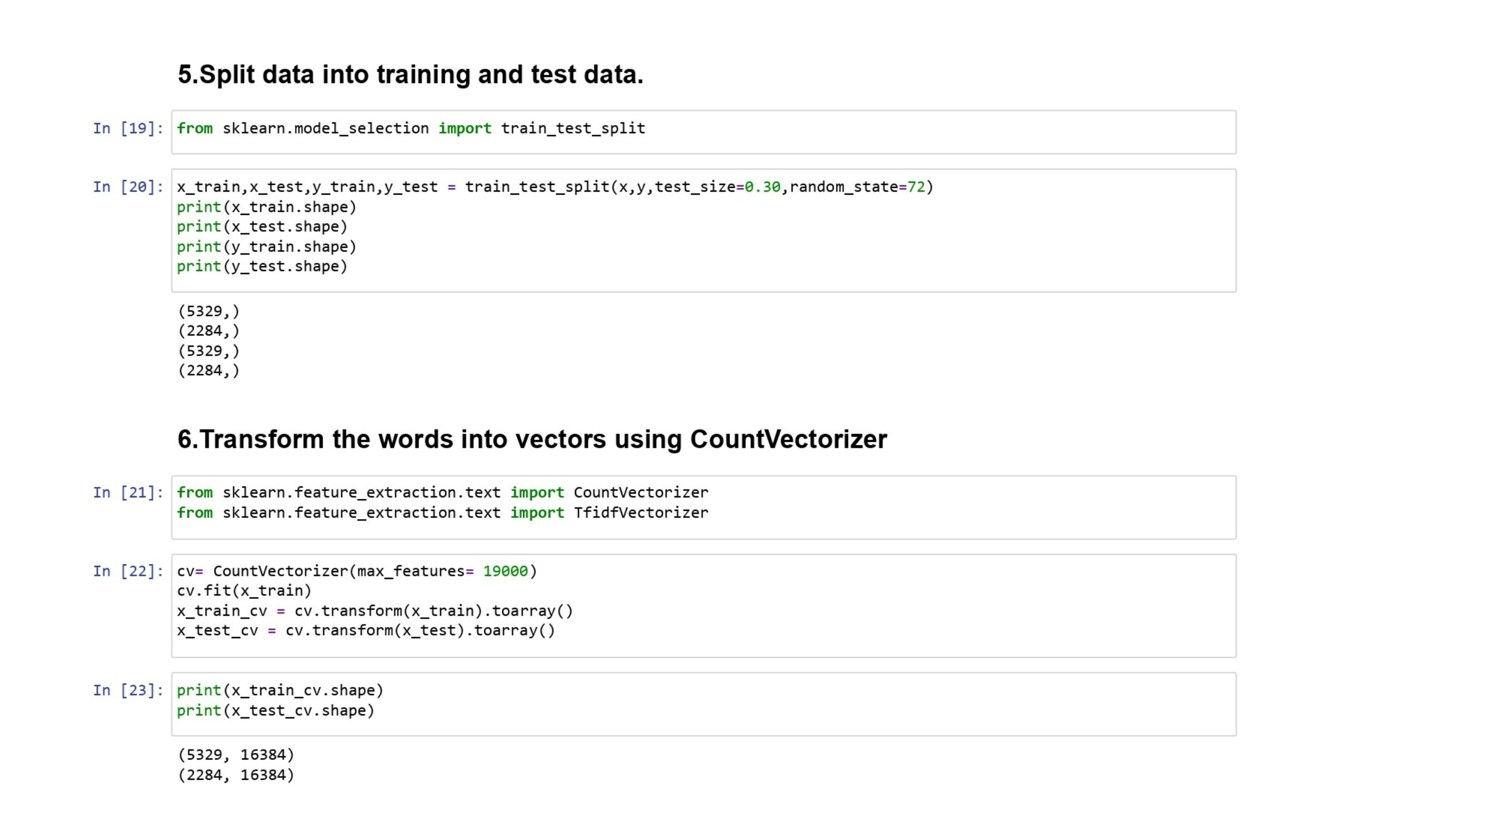

Slide 20
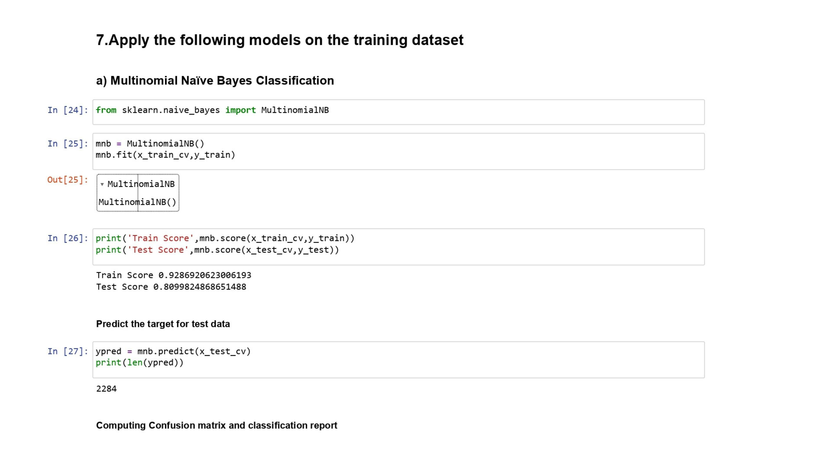

Slide 21
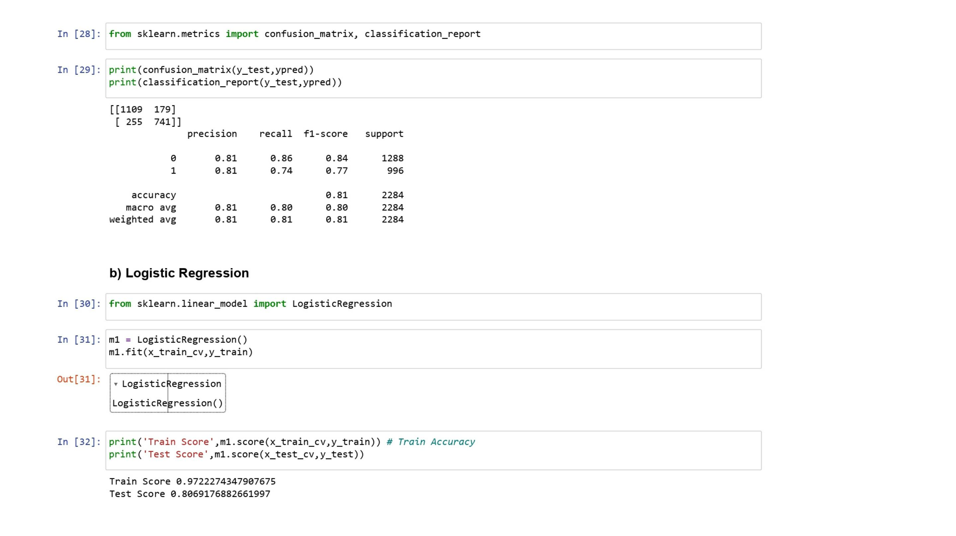

Slide 22
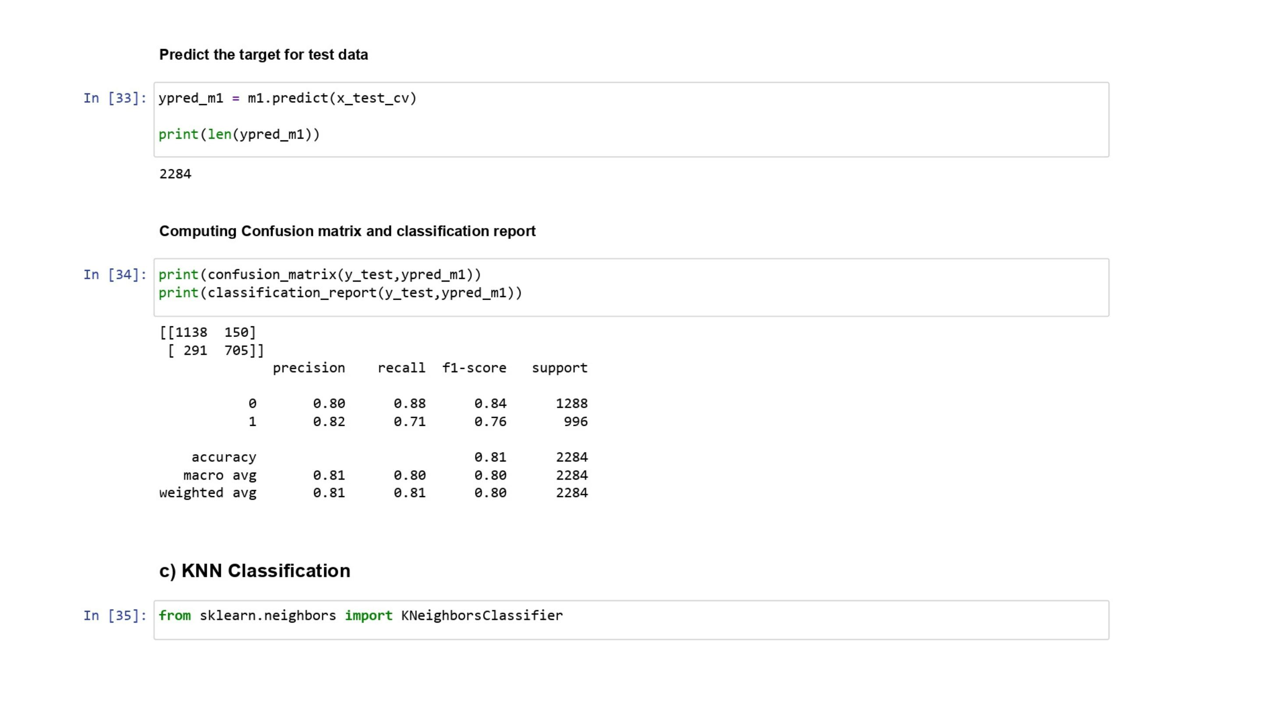

Slide 23
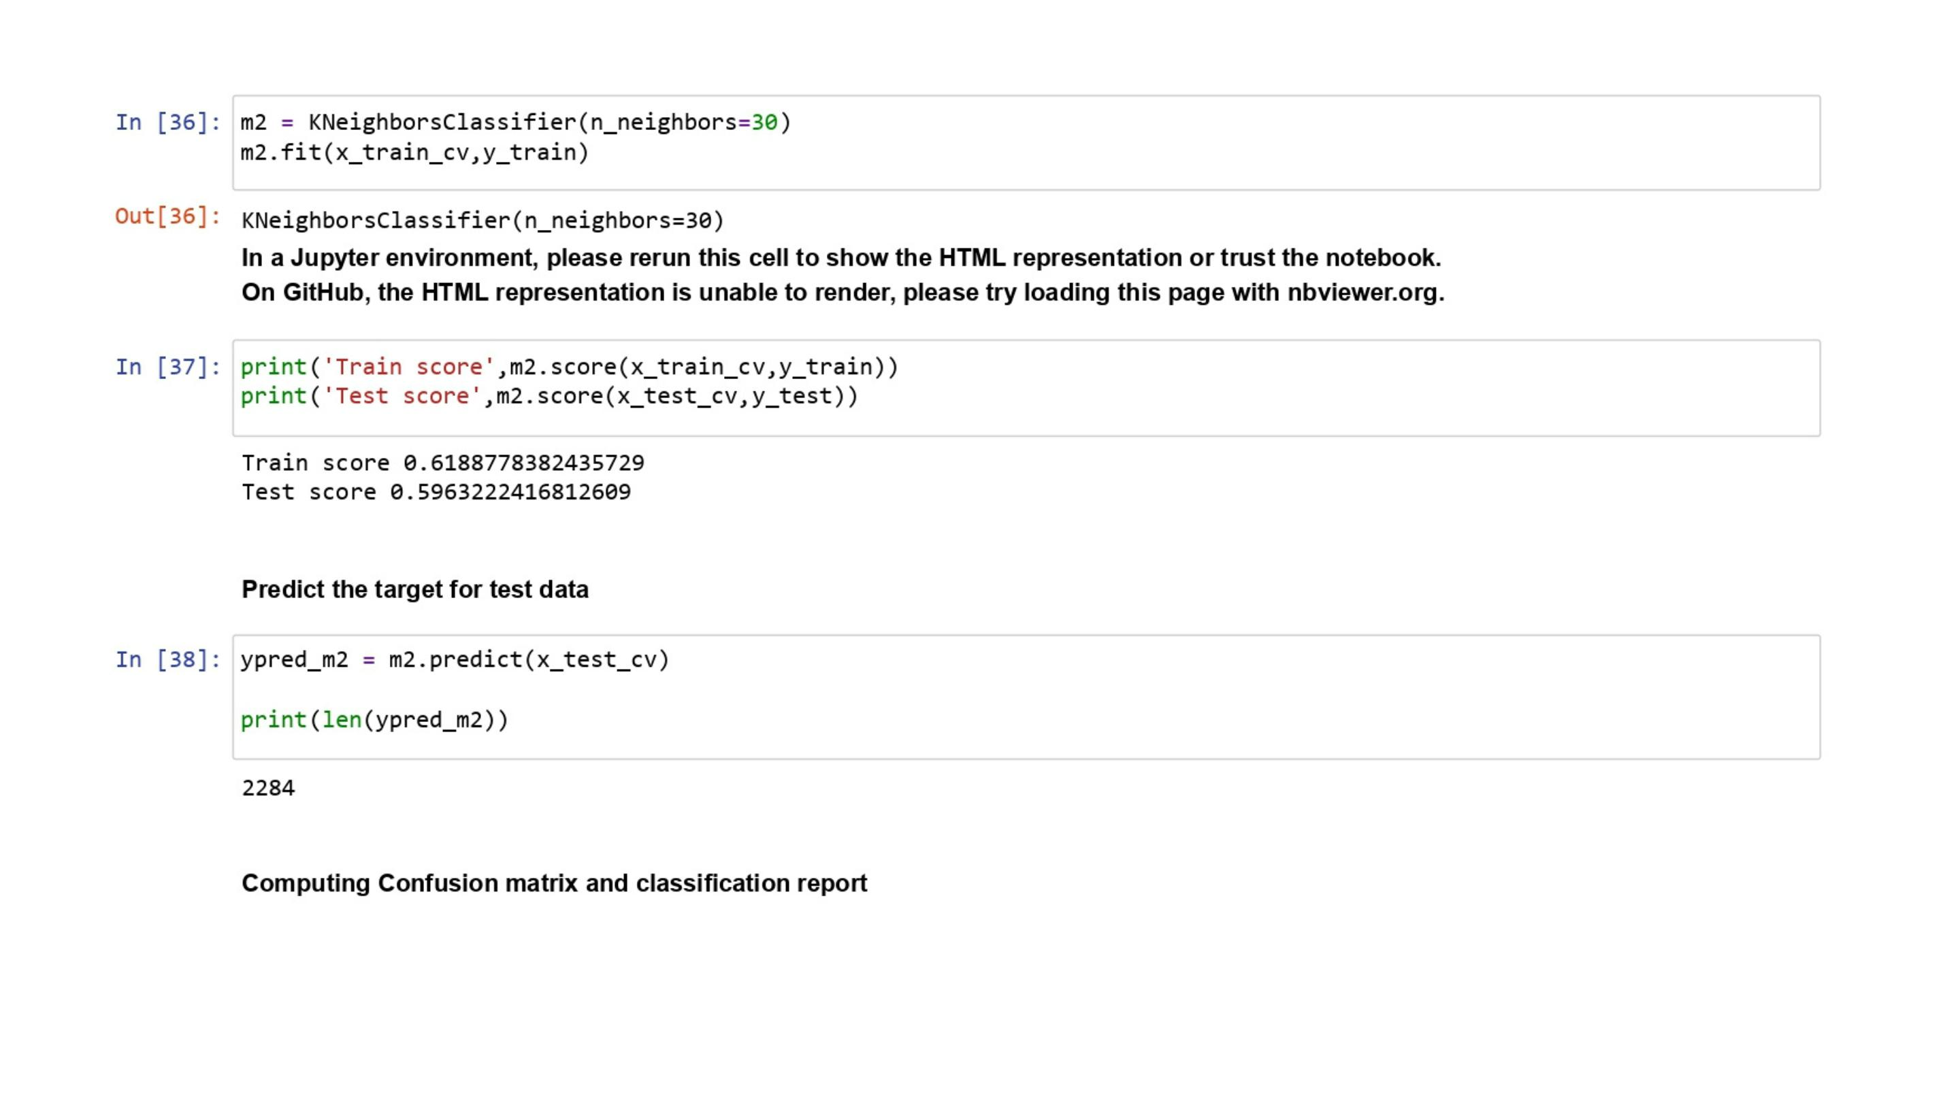

Slide 24
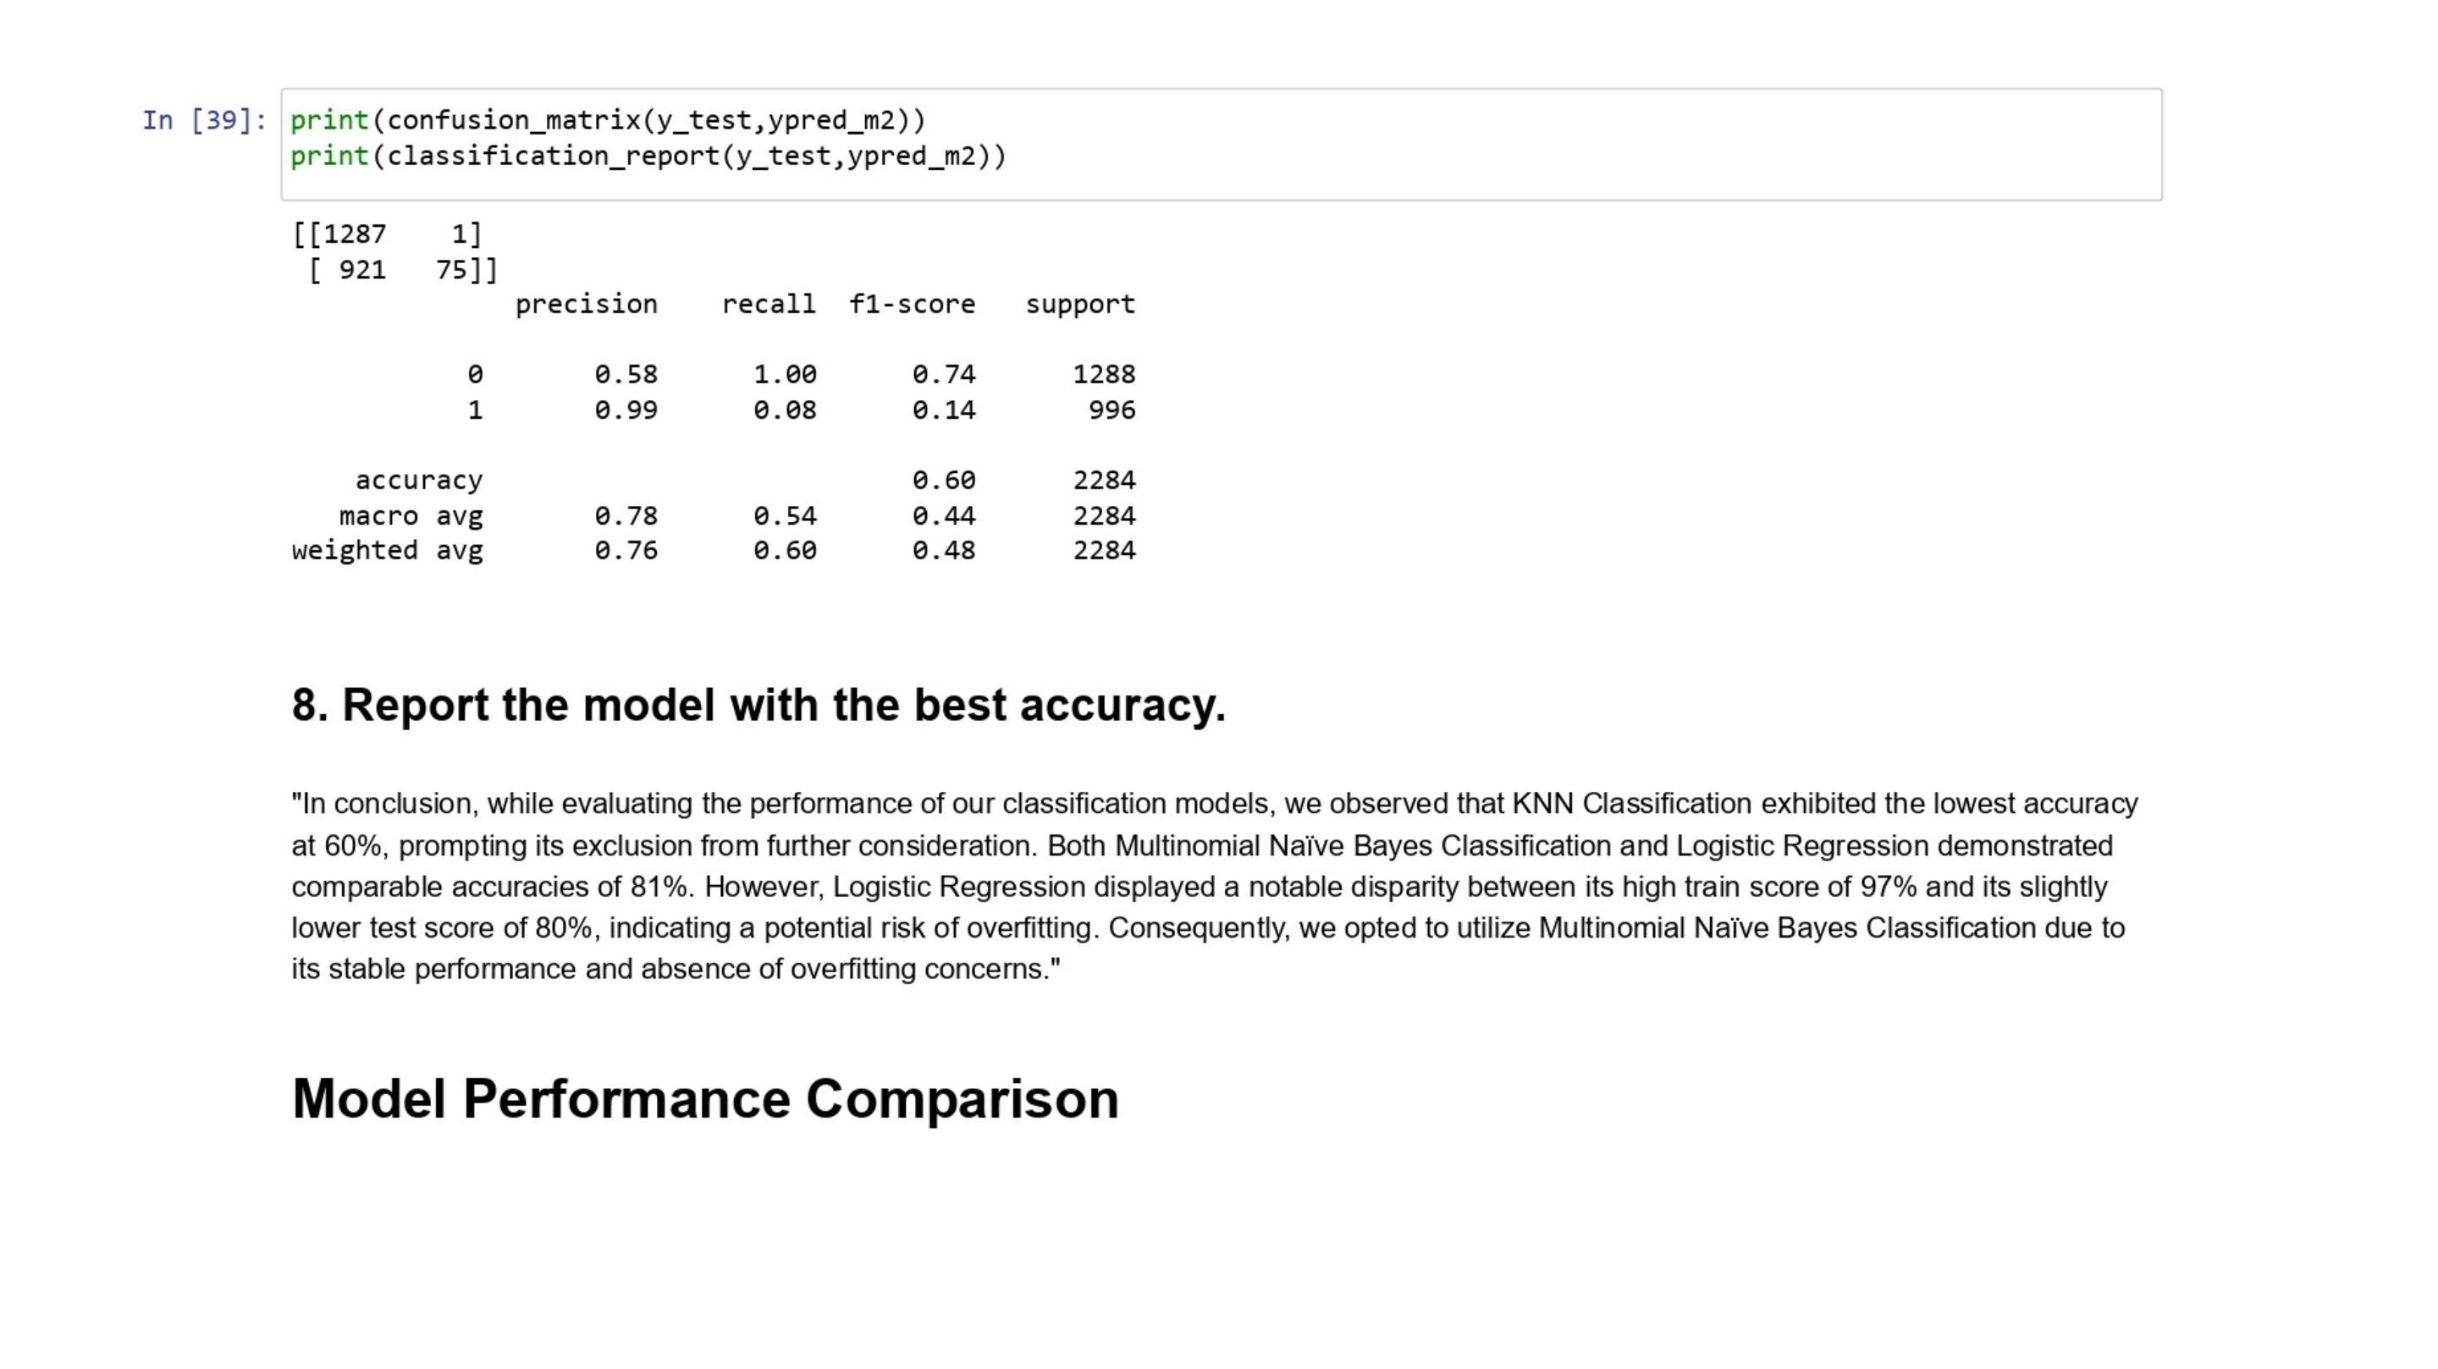

Slide 25
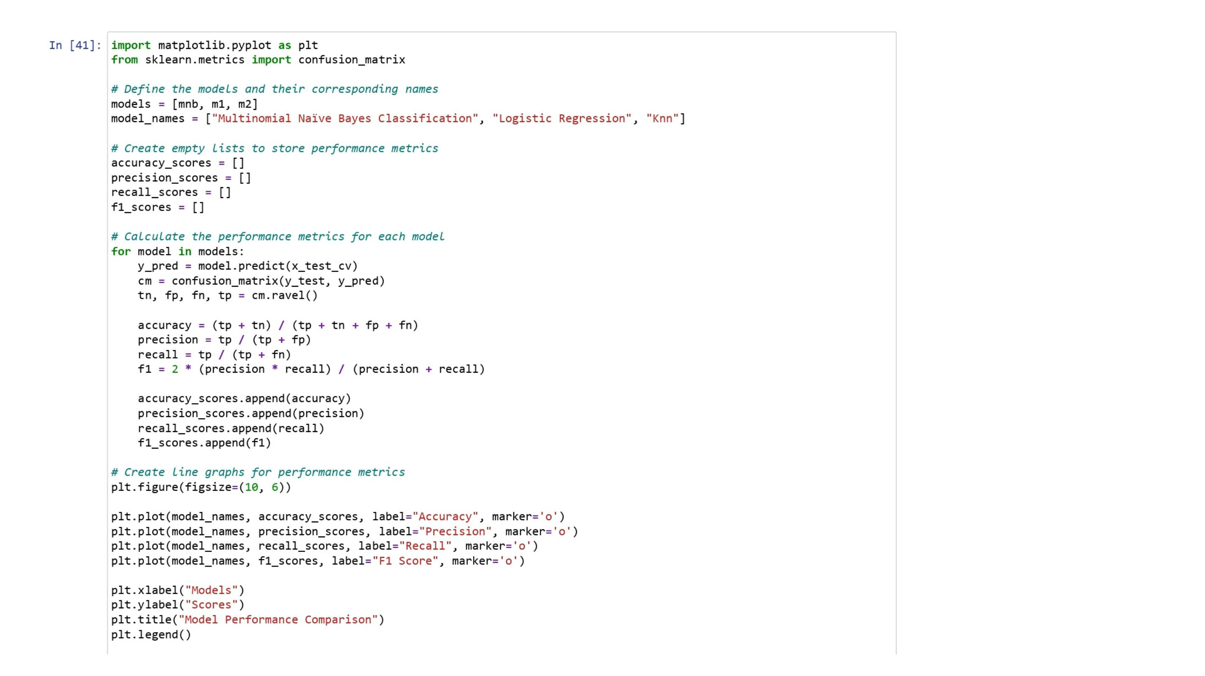

Slide 26
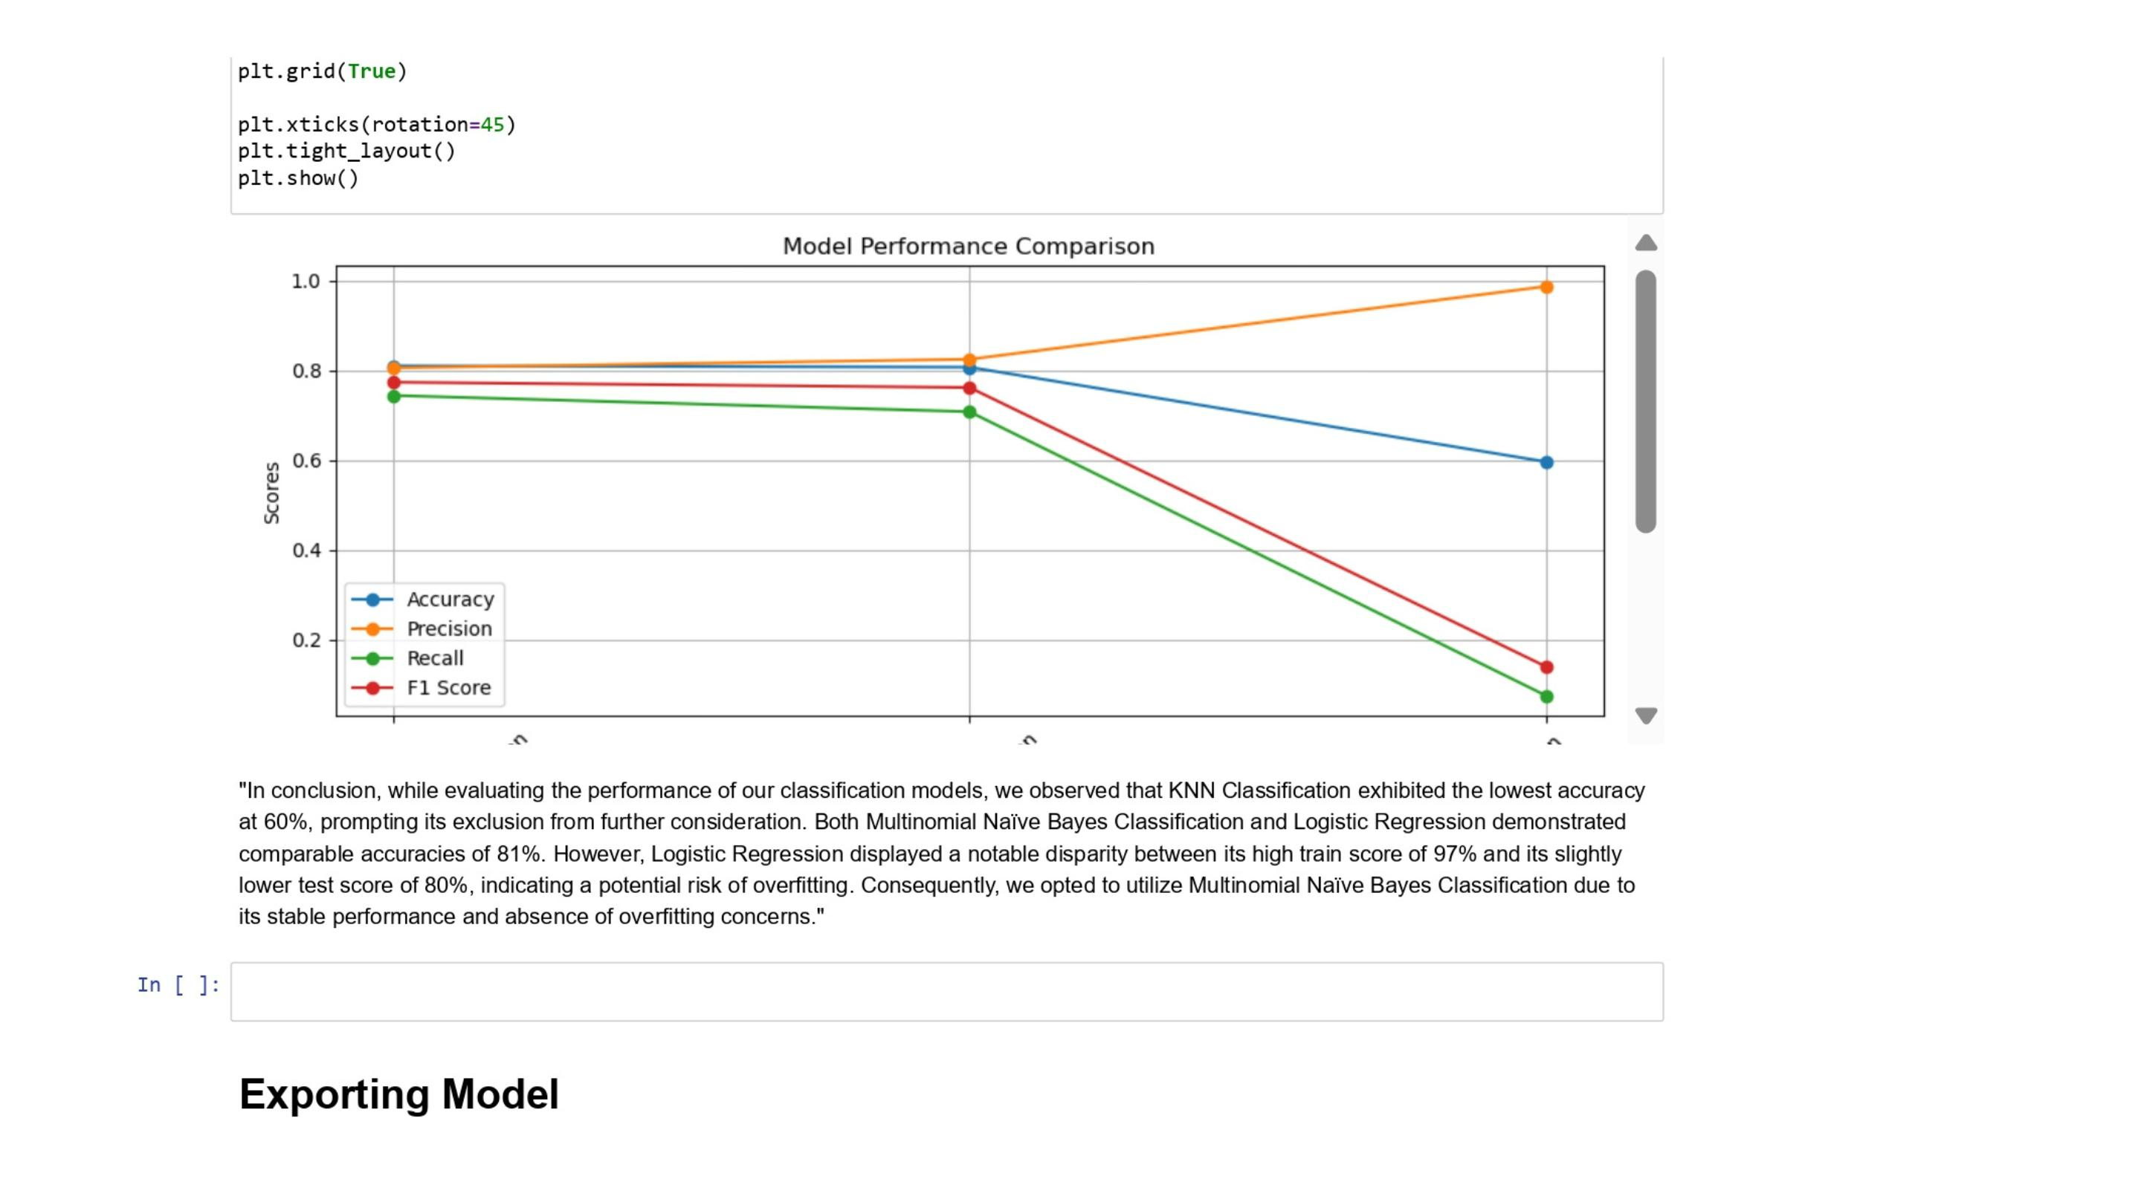

Slide 27
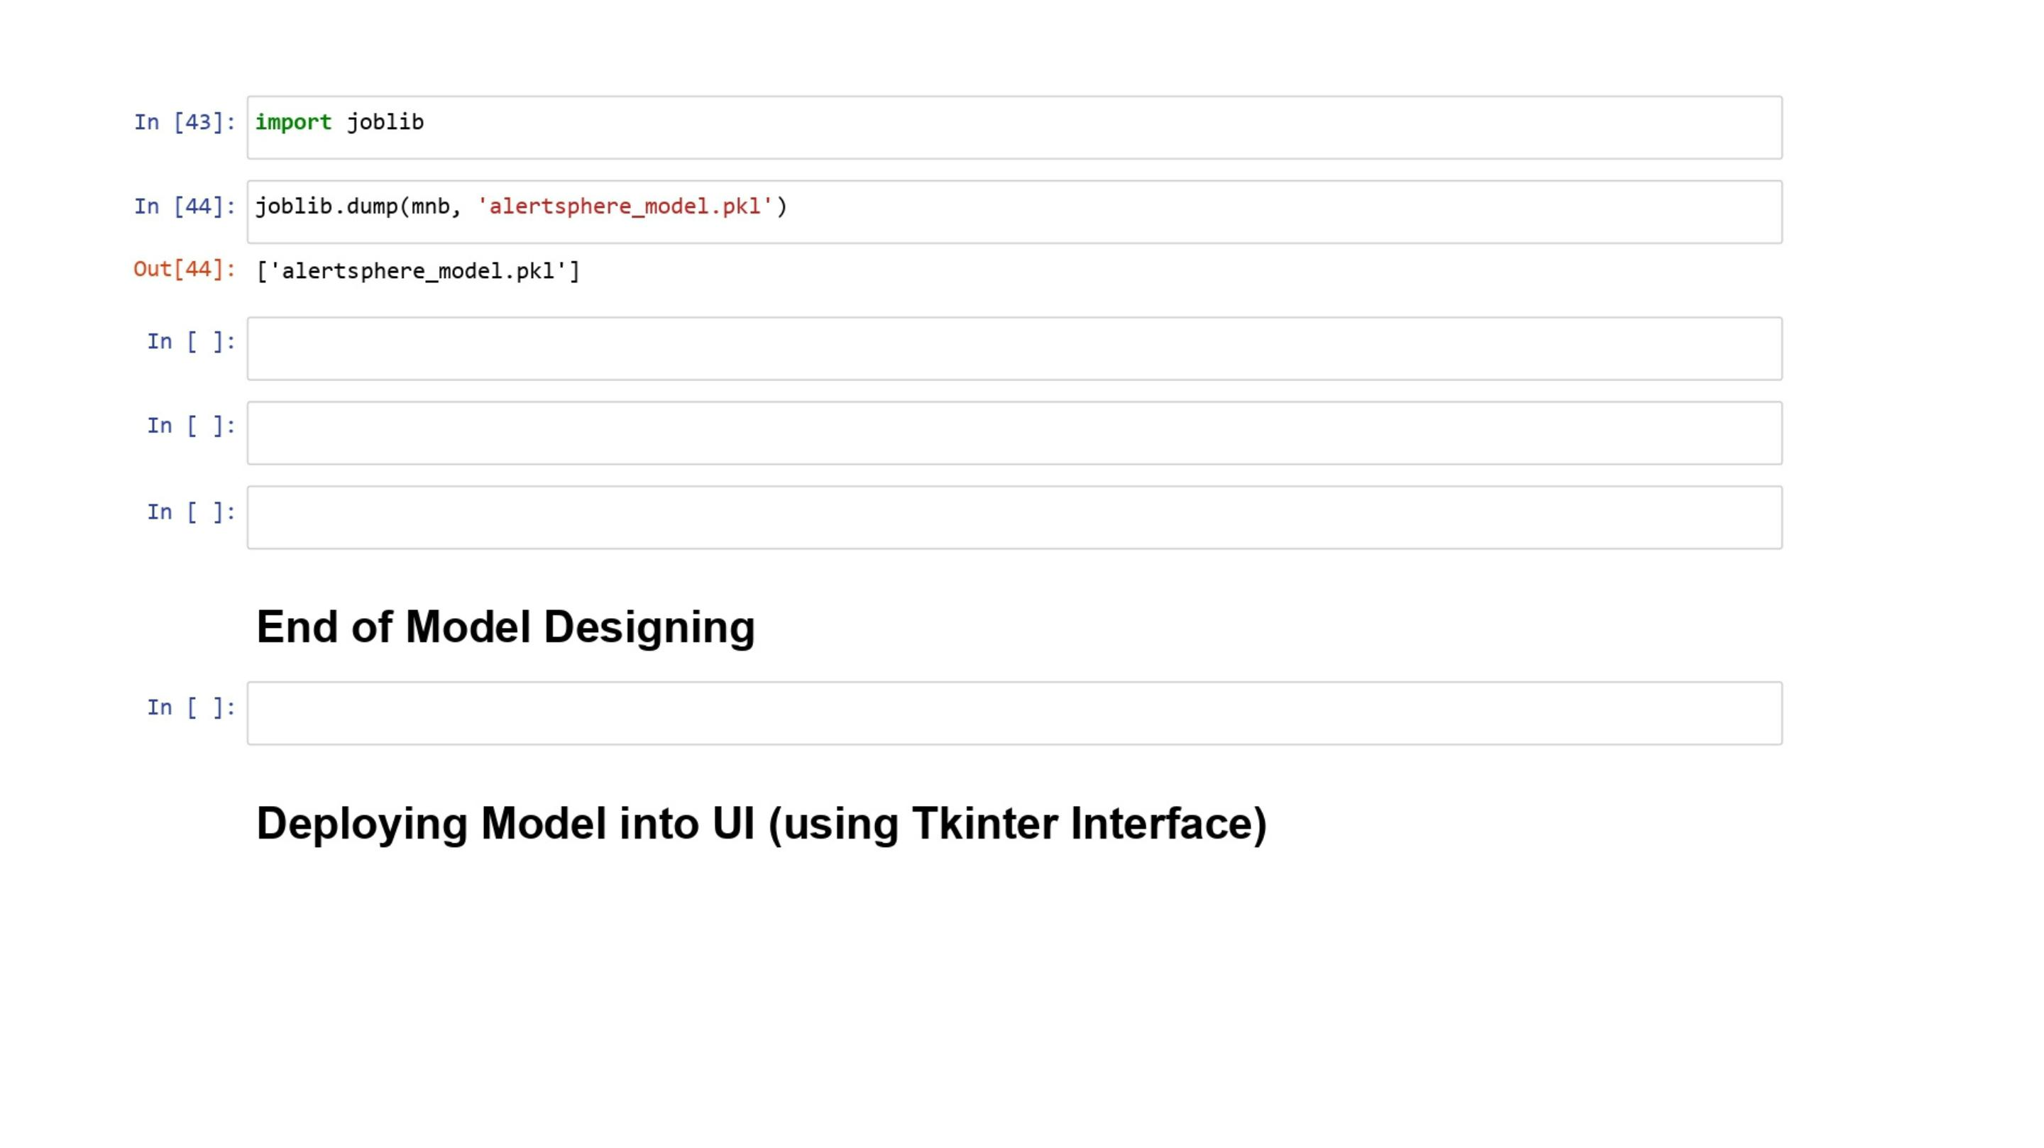

Slide 28
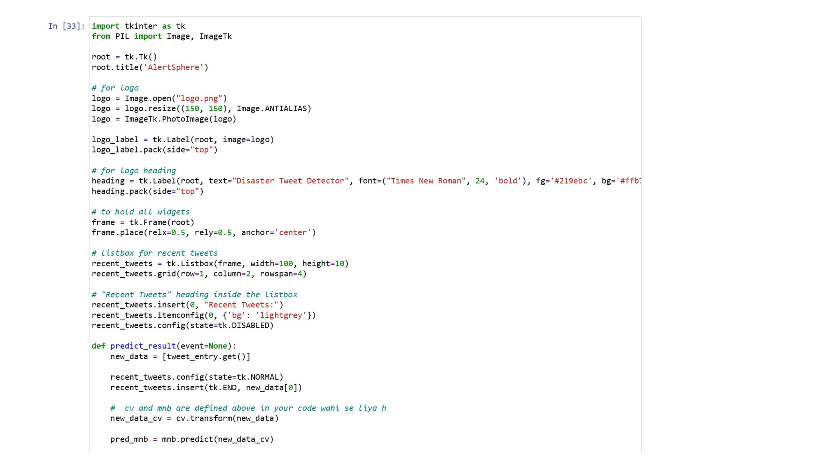

Slide 29
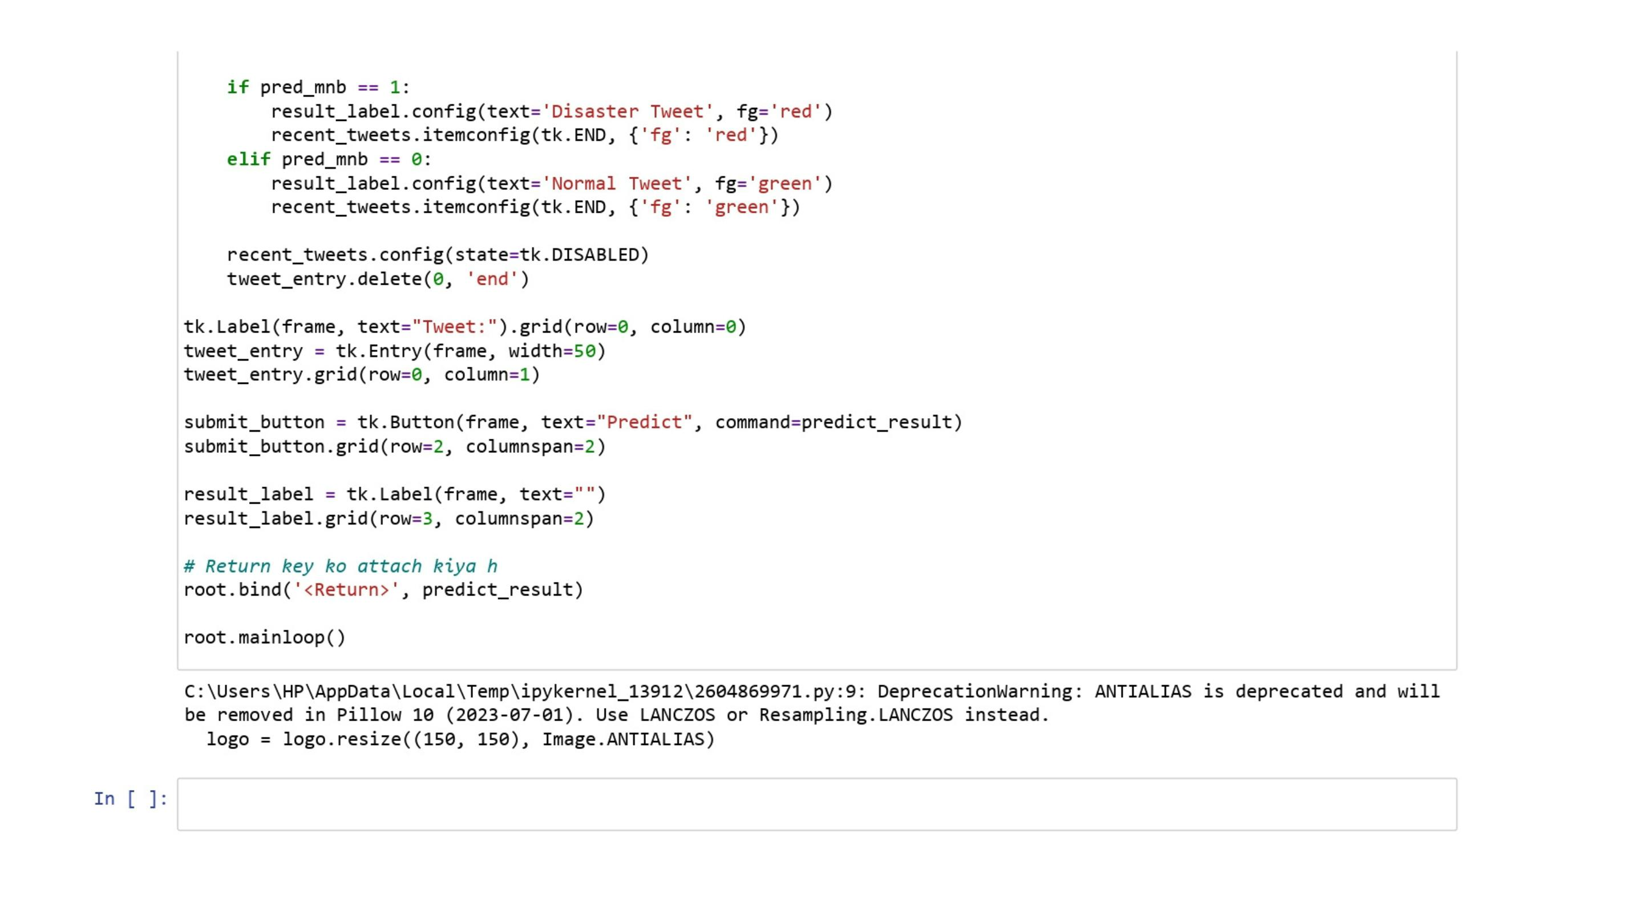

Slide 30
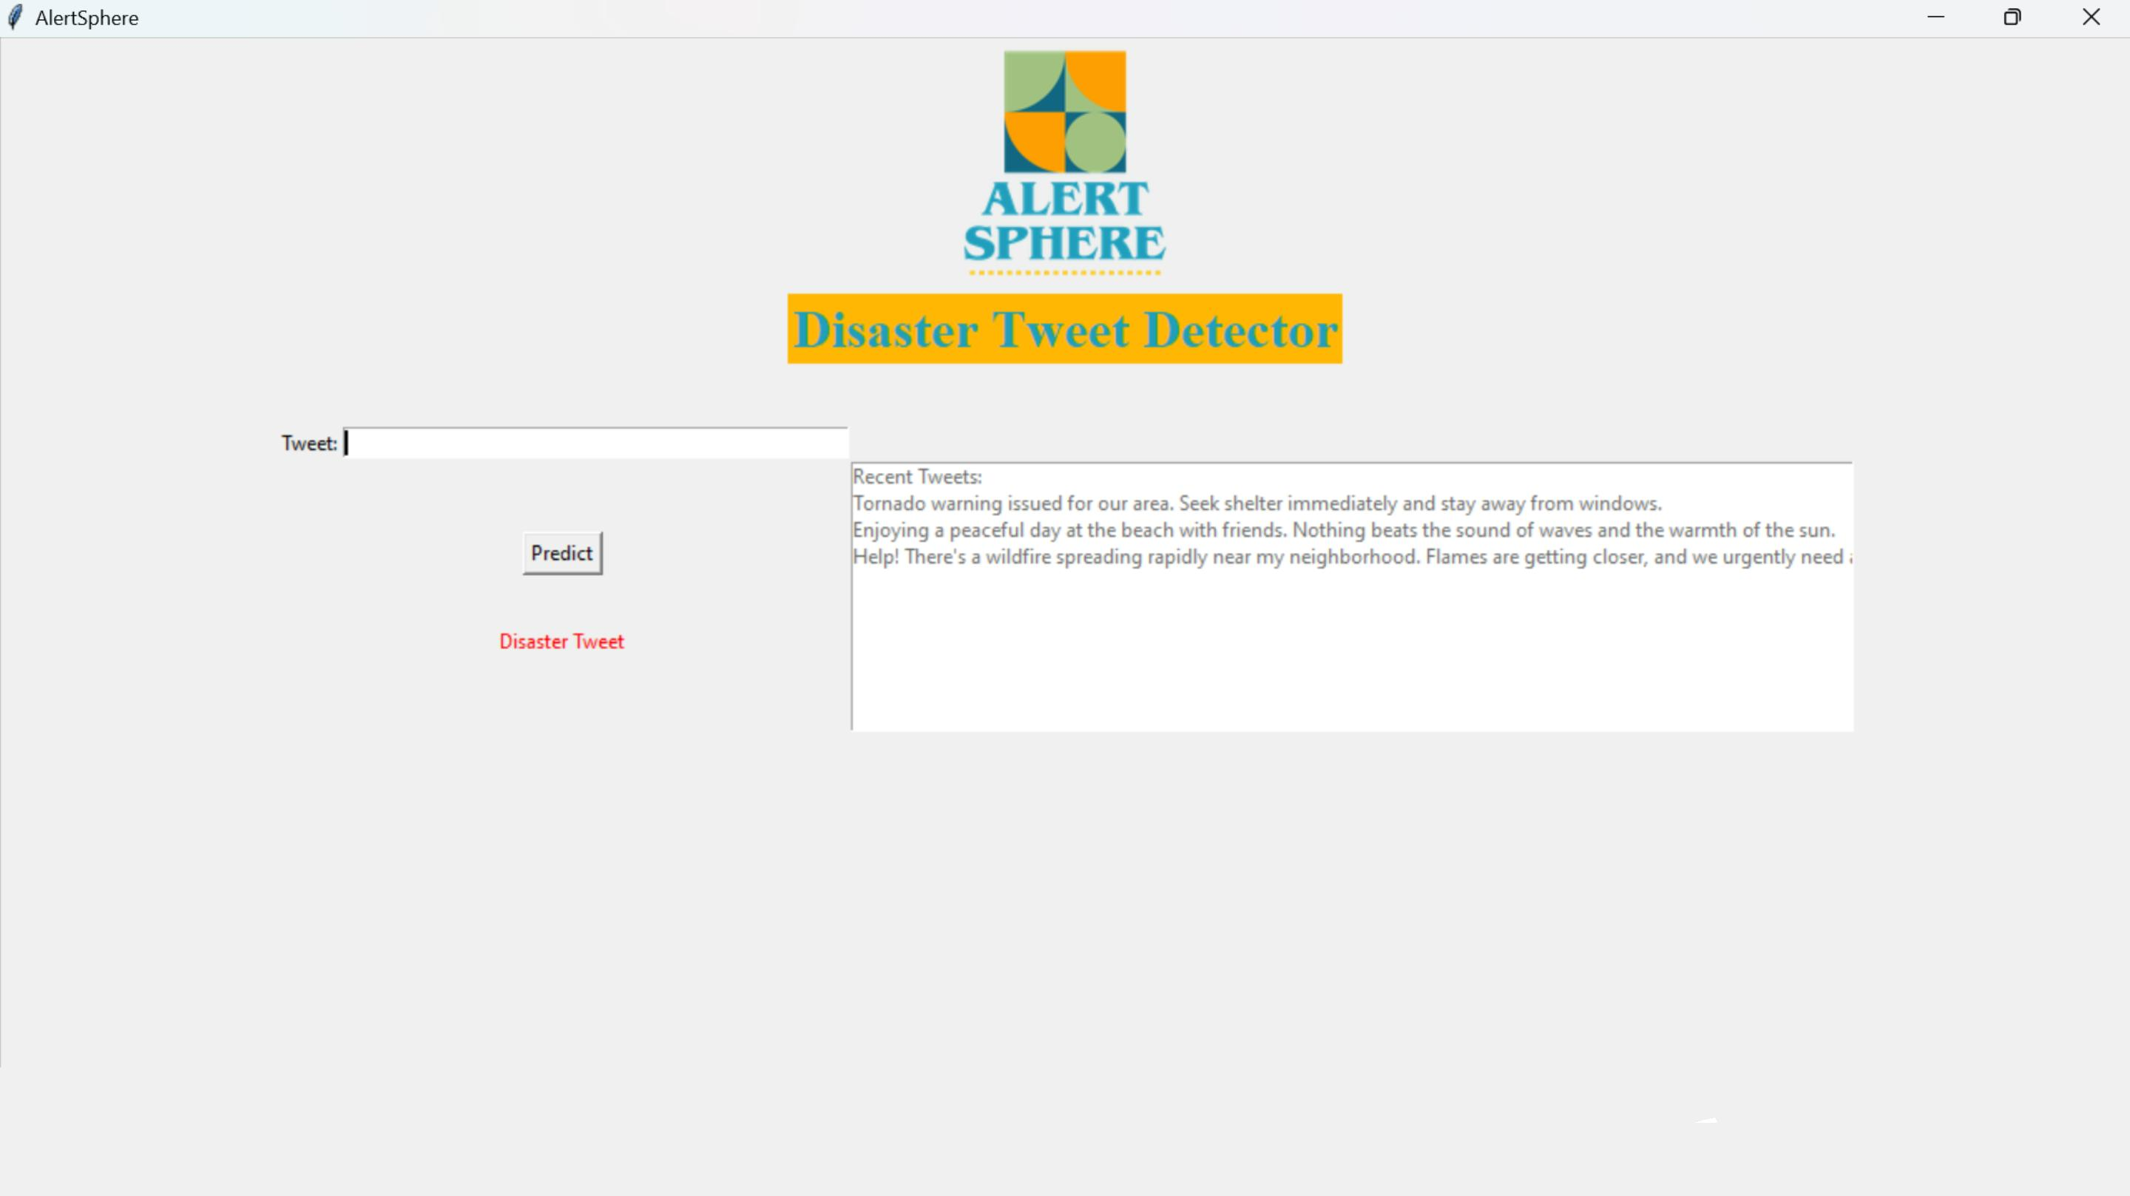

Slide 31
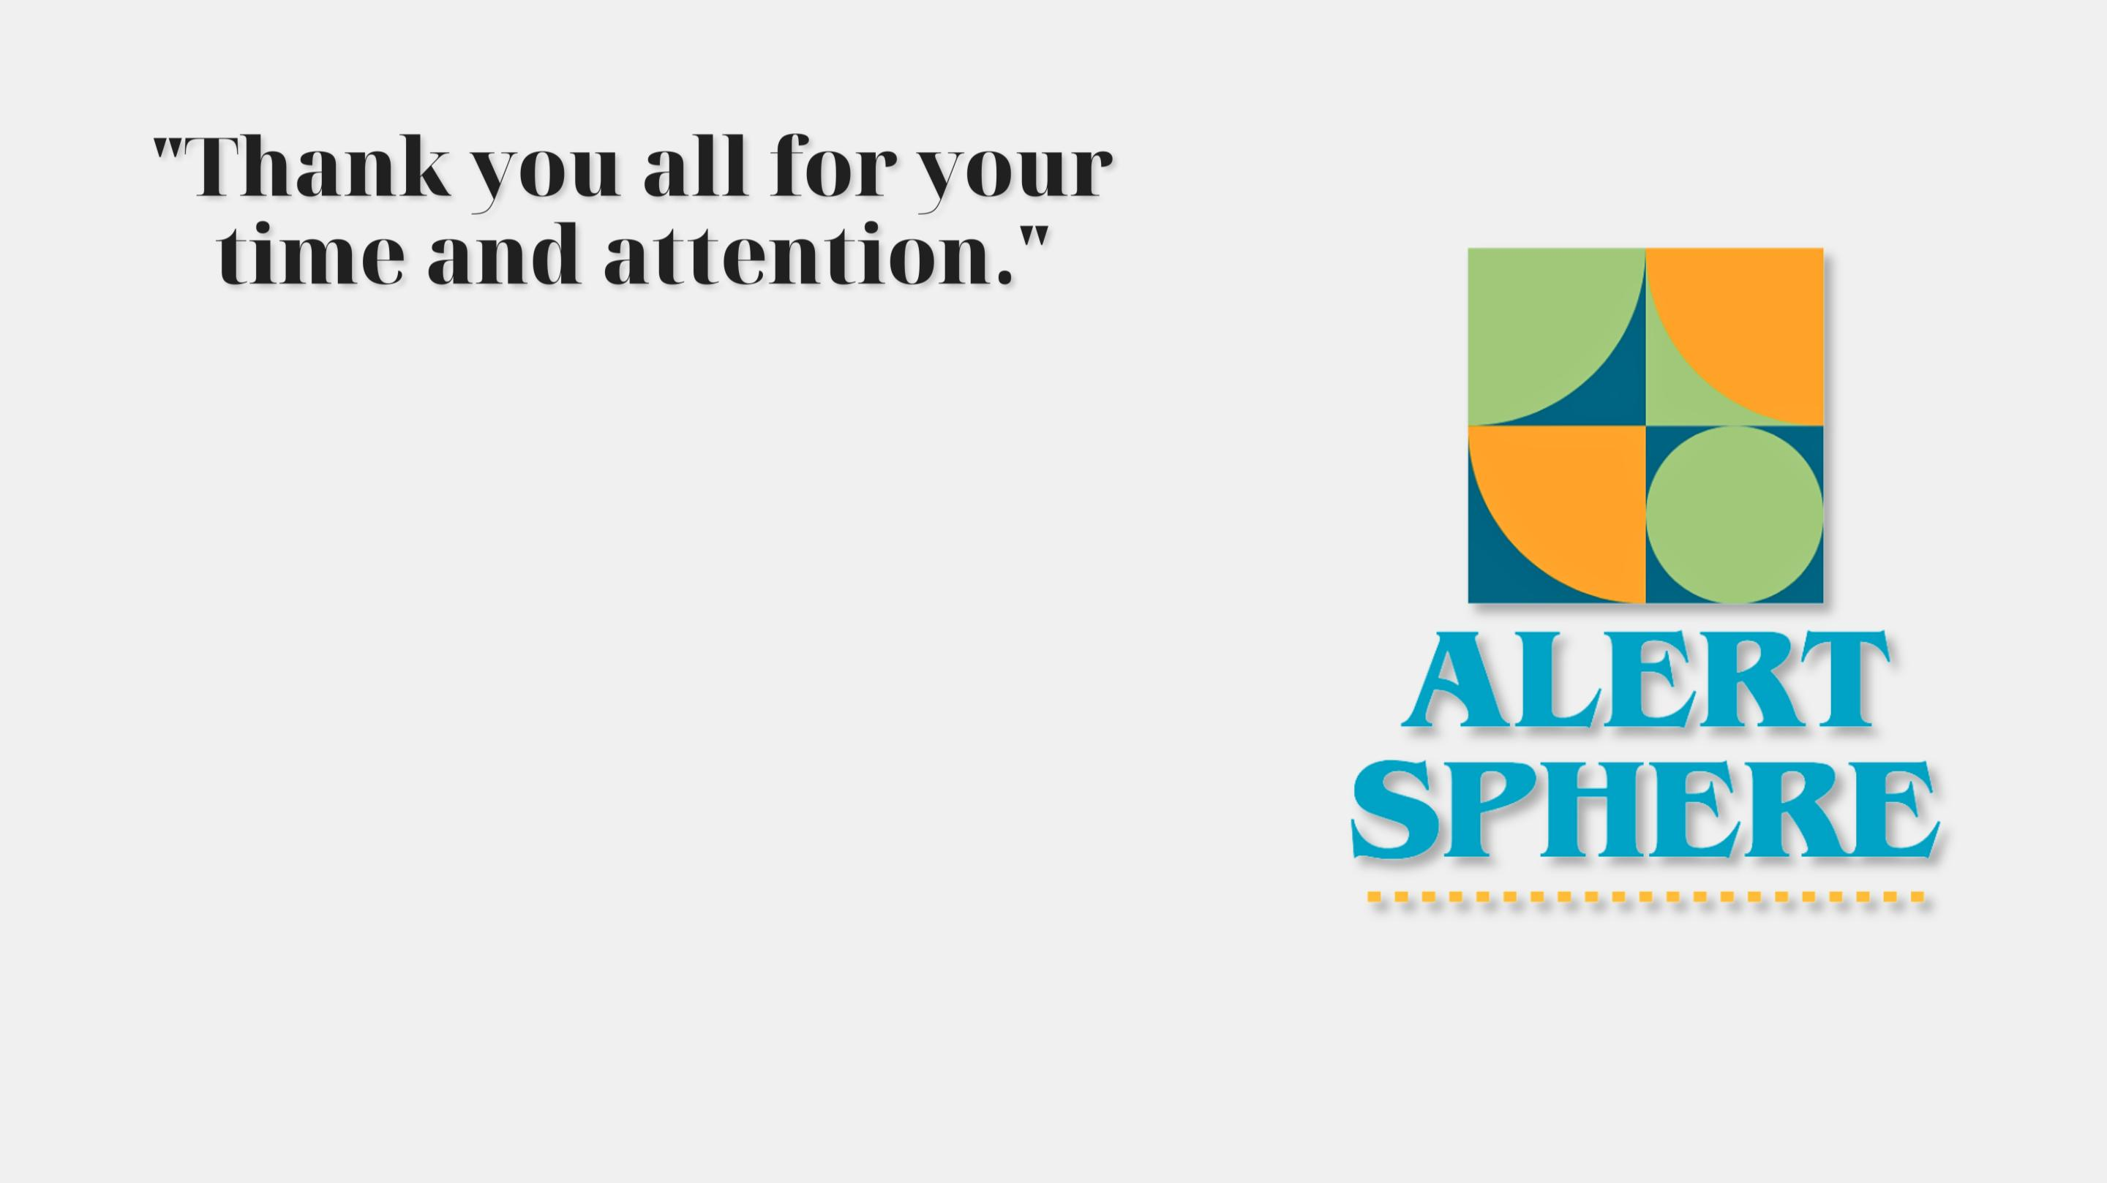
Special Thanks to our supervisor Mr. Aaftab Alam
for his invaluable guidance and support throughout
this project.
We would also like to acknowledge the efforts of our
project team for their dedication and hard work:
1. Al Saim Shakeel (Leader)
2. Mohd. Faraz Khan
3. Ahtisham Riyasat
Your collective contributions have been instrumental
in the success of this project.

